Slide 1
Lysozyme Plate
Author Names

Slide 2
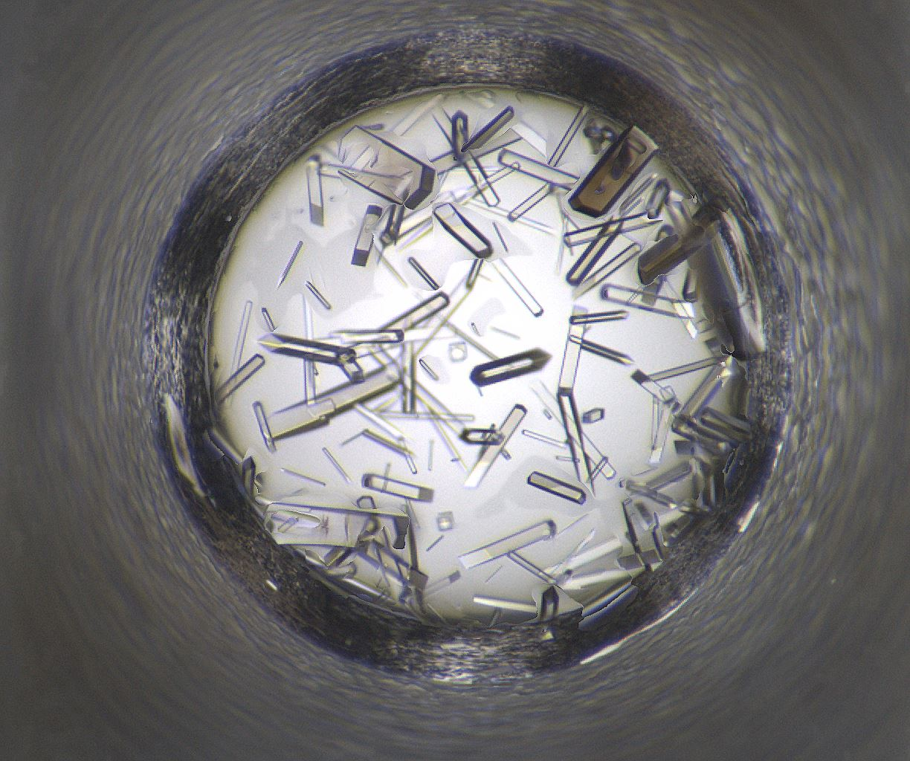
Well Number 114
Well Num: 114 MARCO Class: Crystals Human Class: Crystals MARCO Confidence: 93.5 % Date: 08/22/2020 Spectrum: Visible Cocktail 17_C0869 ------------------ pH: 4.2 Potassium bromide 0.1 M Sodium Citrate 0.1 M PEG 400 40.0 v/v

Slide 3

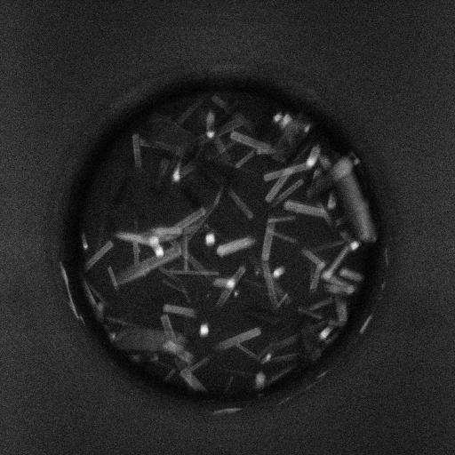
Well 114 Alternate Imagers
SHG
Visible
UV-TPEF

Slide 4
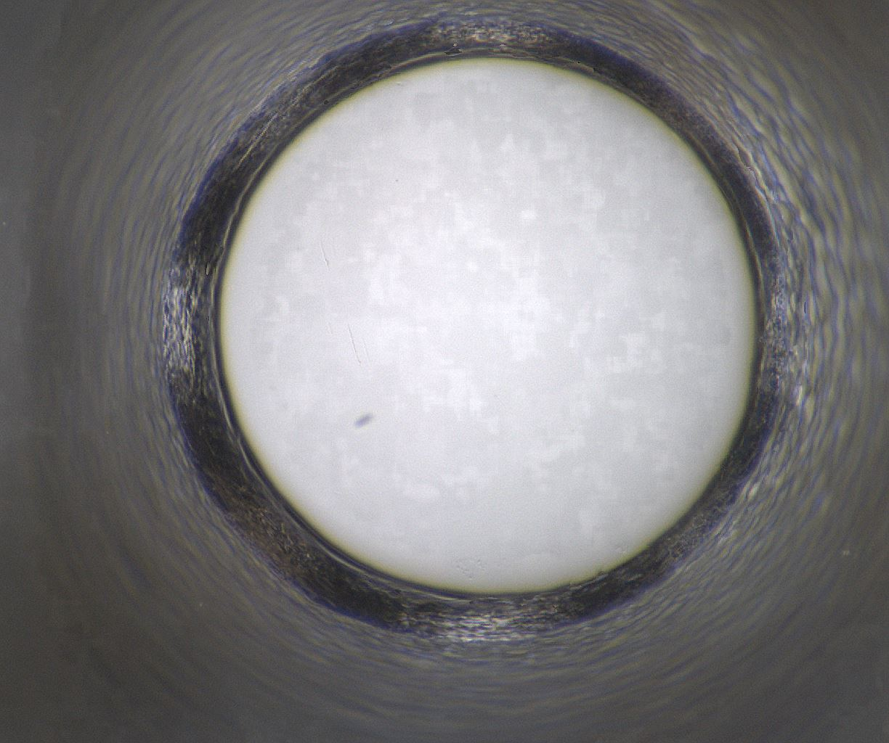
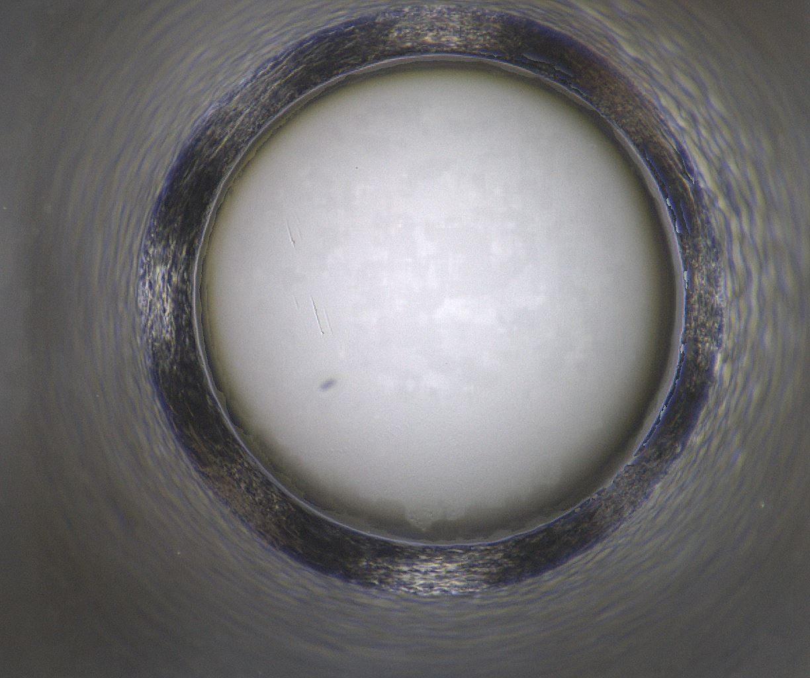
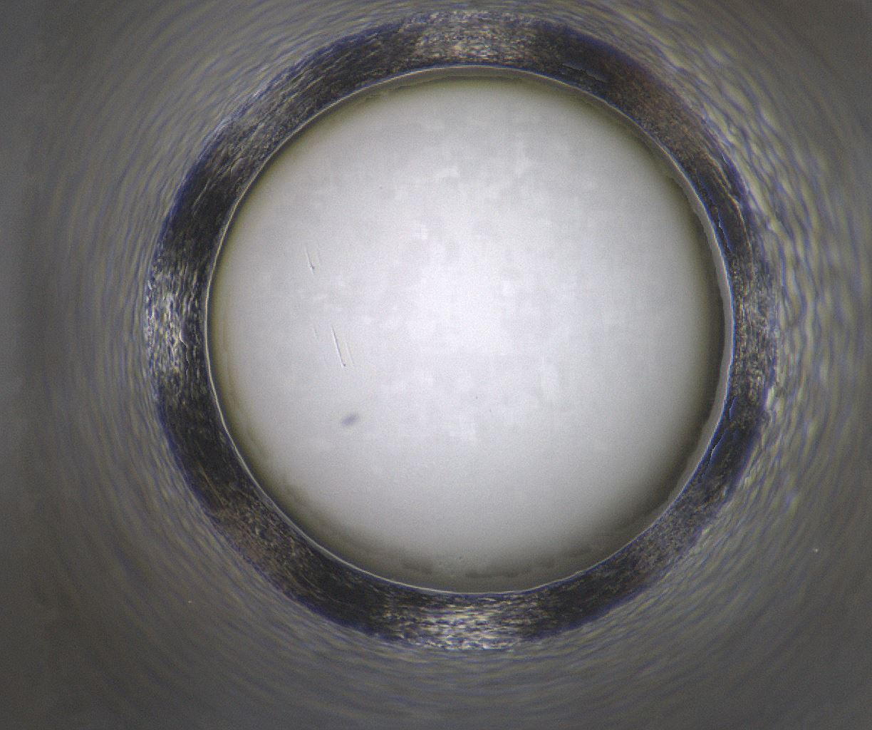
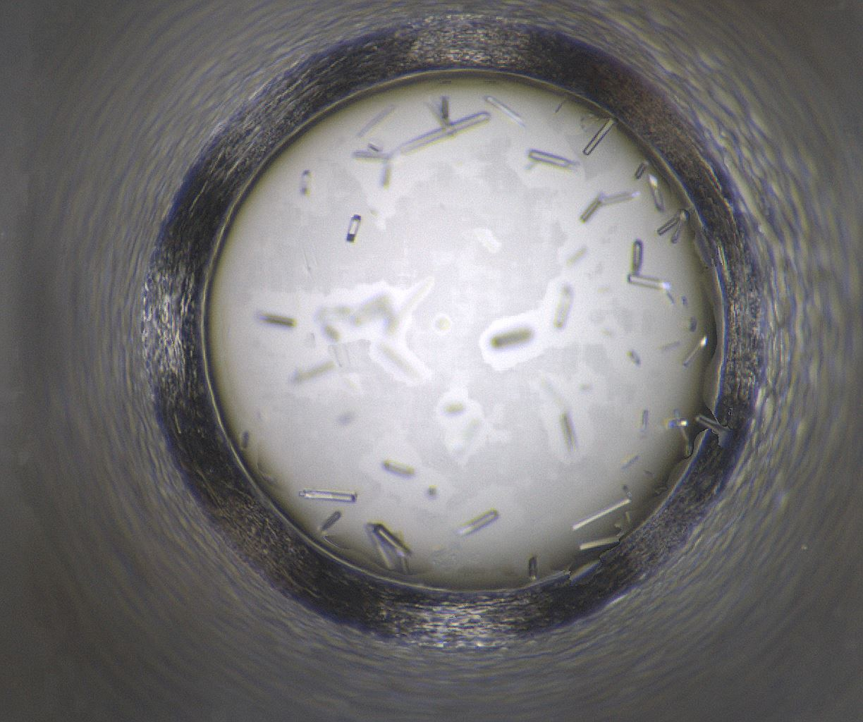
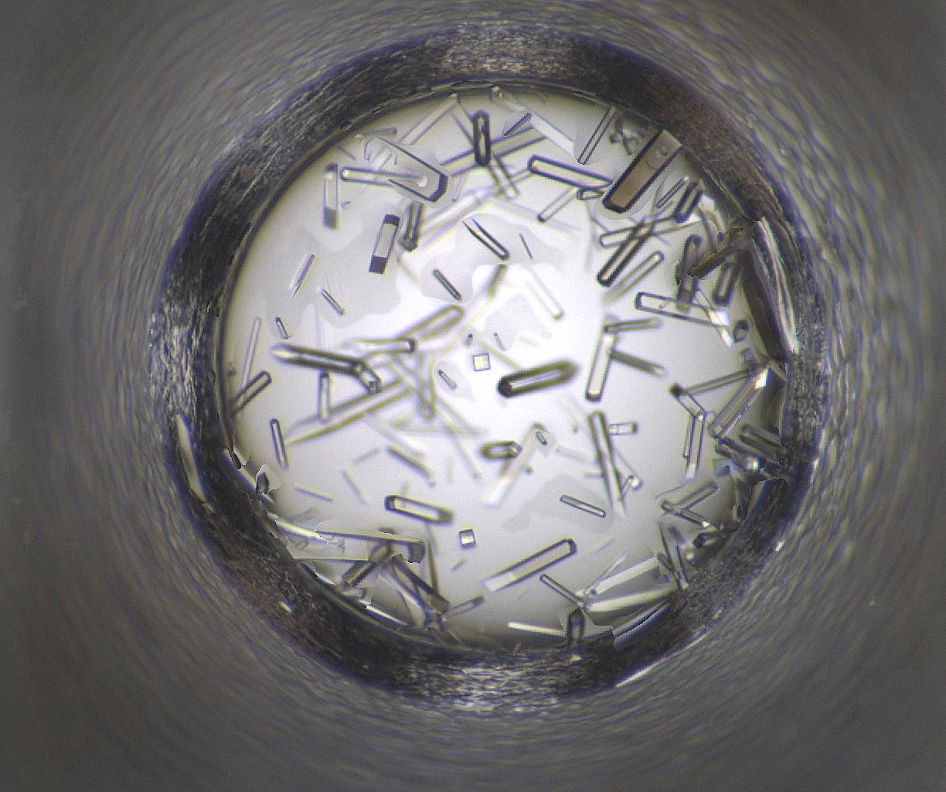
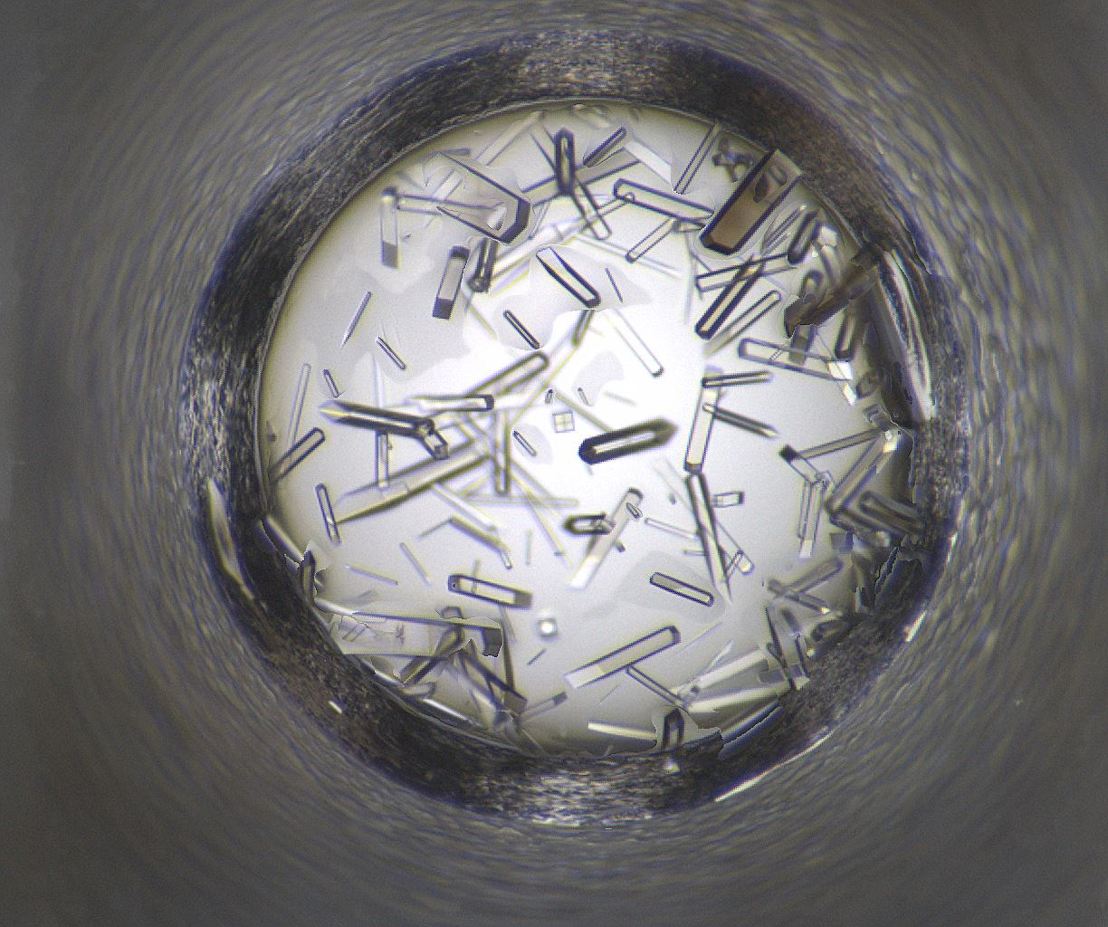
Well 114: 08/11/2020 - 08/22/2020
08/11/2020
08/12/2020
08/13/2020
08/15/2020
08/18/2020
08/19/2020
08/22/2020

Slide 5
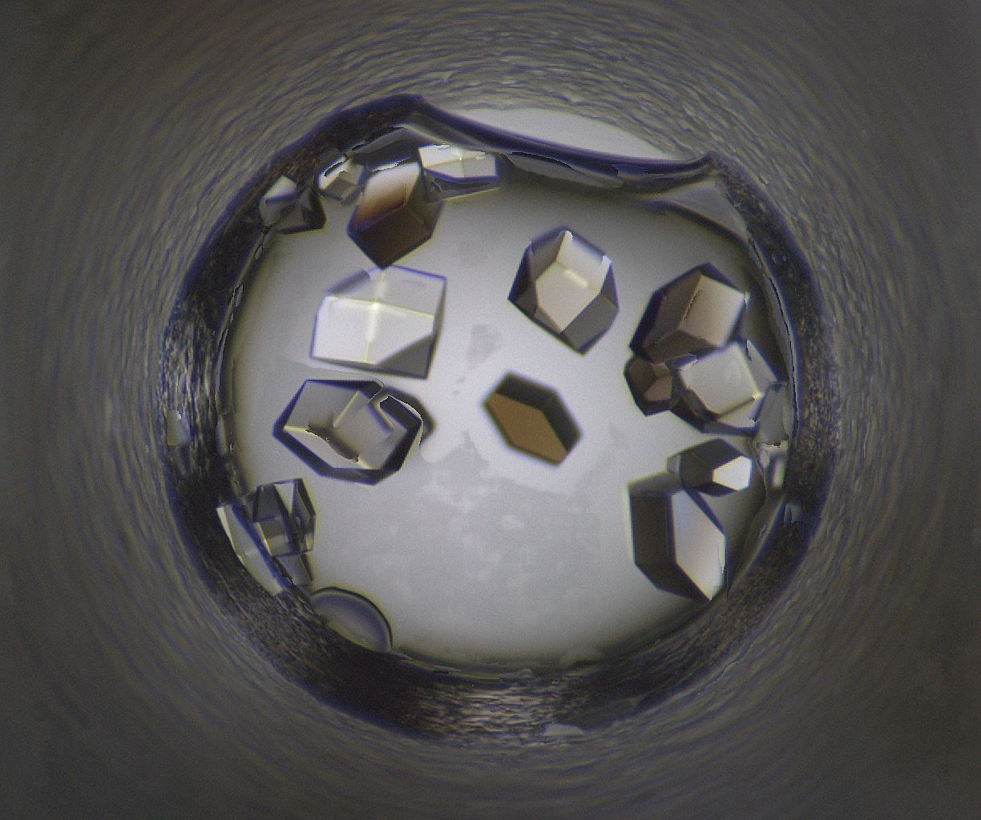
Well Number 176
Well Num: 176 MARCO Class: Crystals Human Class: Crystals MARCO Confidence: 93.5 % Date: 08/22/2020 Spectrum: Visible Cocktail 17_C1448 ------------------ pH: 8.5 Ammonium chloride 3.5 M tris 0.1 M

Slide 6

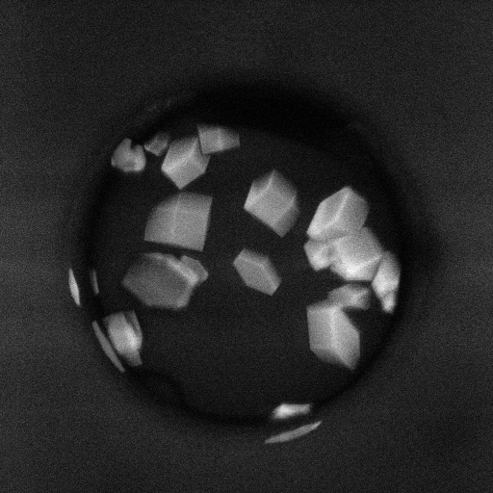
Well 176 Alternate Imagers
SHG
Visible
UV-TPEF

Slide 7
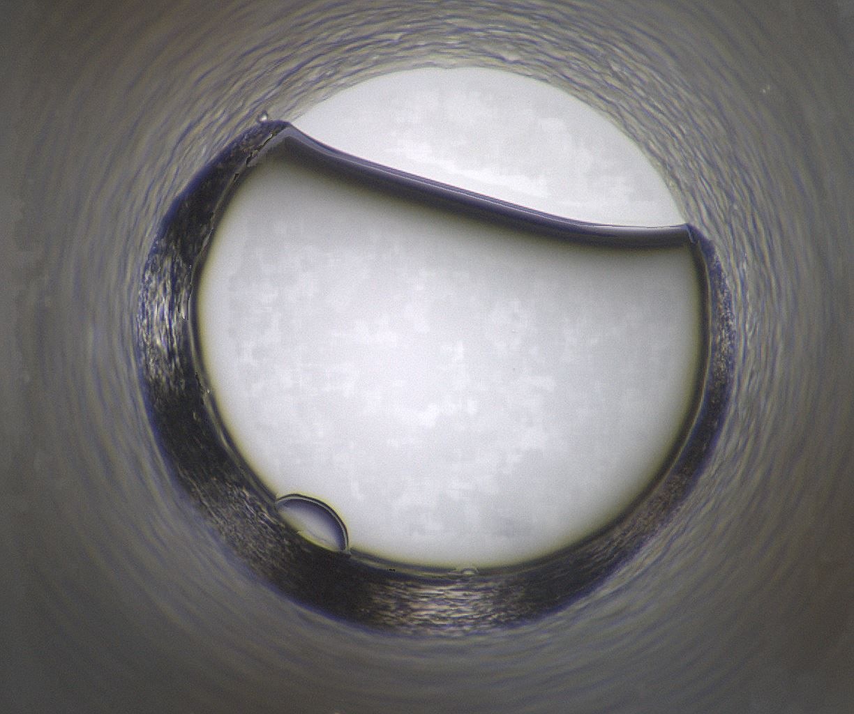
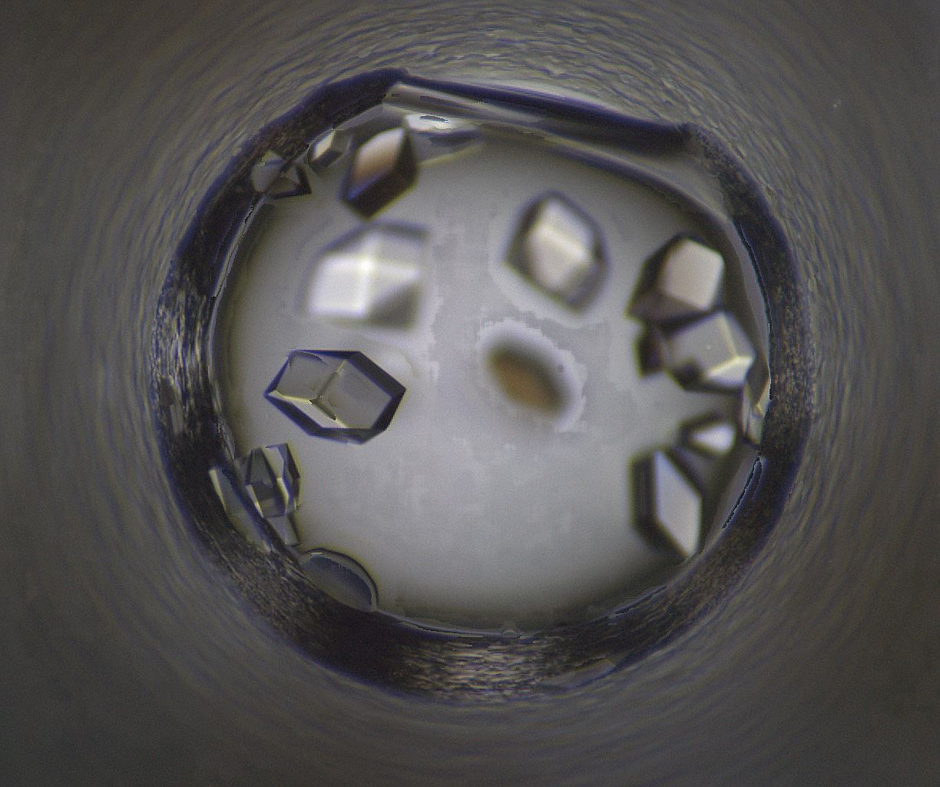

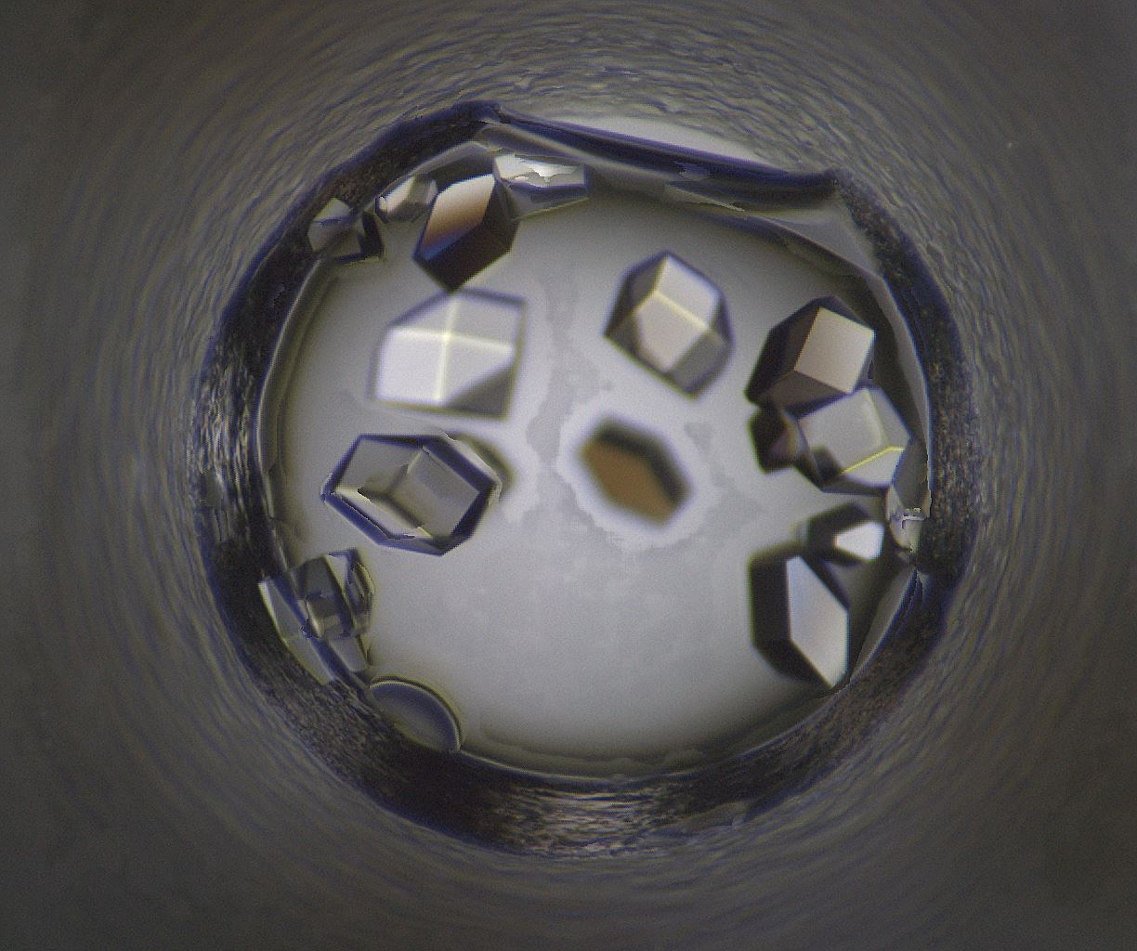
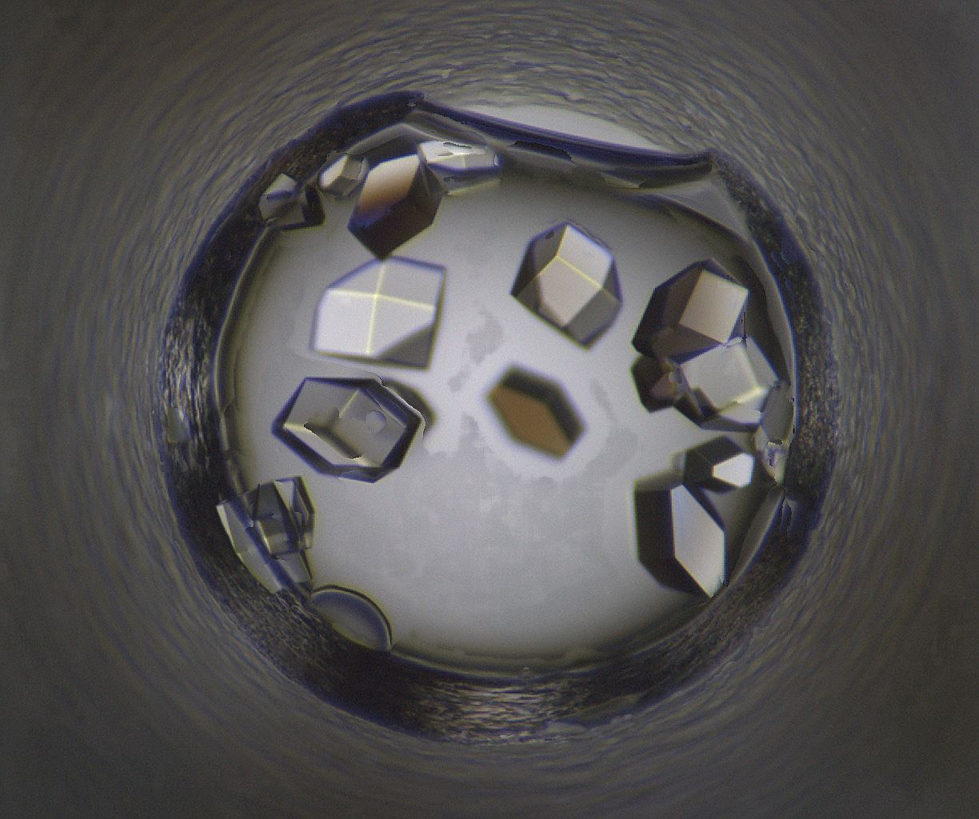
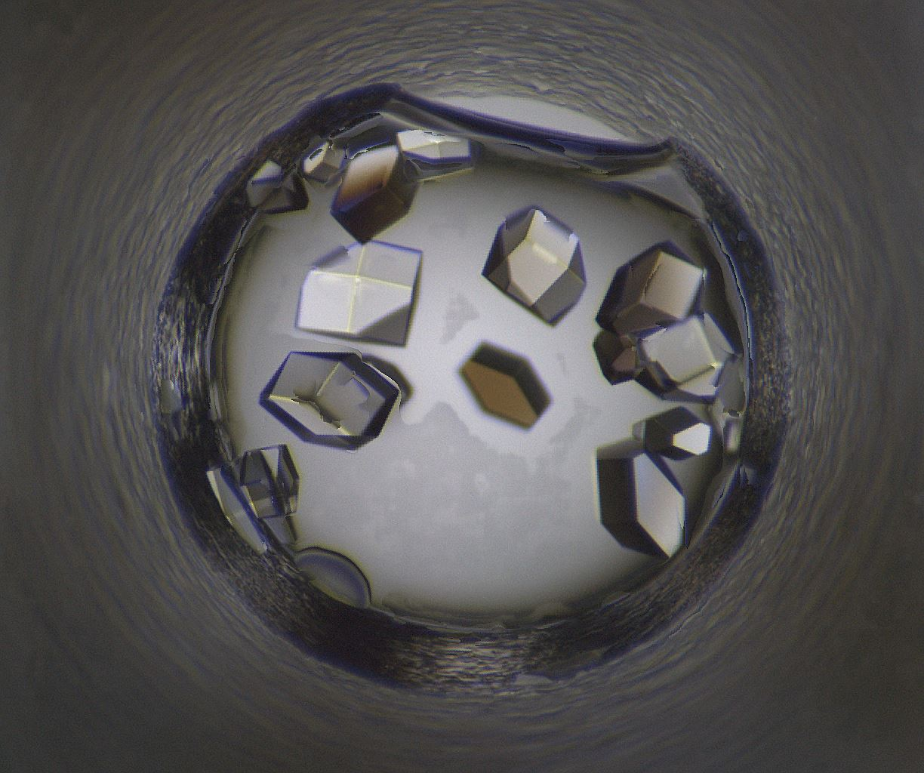
Well 176: 08/11/2020 - 08/22/2020
08/11/2020
08/12/2020
08/13/2020
08/15/2020
08/18/2020
08/19/2020
08/22/2020

Slide 8
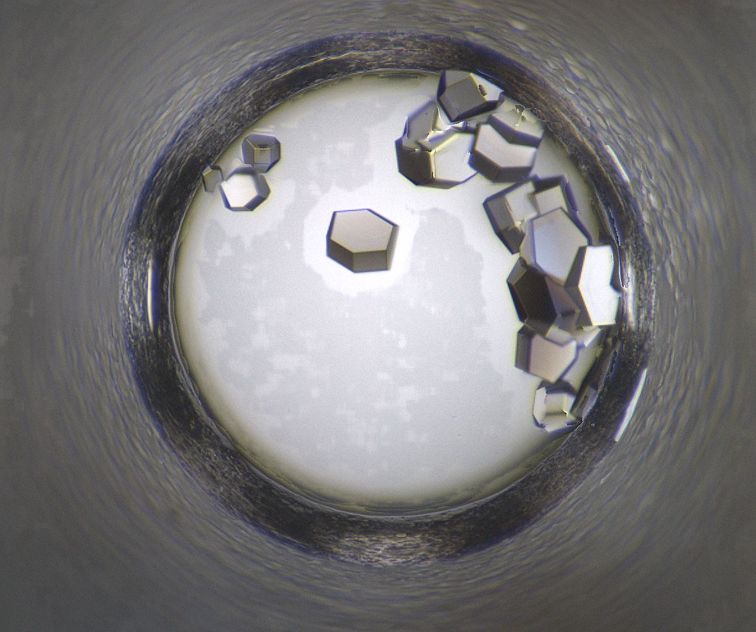
Well Number 205
Well Num: 205 MARCO Class: Crystals Human Class: Crystals MARCO Confidence: 93.8 % Date: 08/22/2020 Spectrum: Visible Cocktail 17_C0016 ------------------ pH: 5.3 DL-Malic acid 0.5 M PEG 3350 15.0 w/v

Slide 9

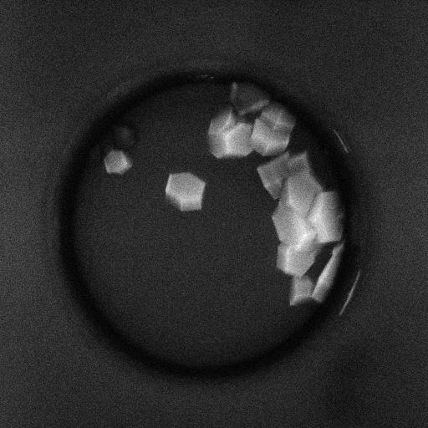
Well 205 Alternate Imagers
SHG
Visible
UV-TPEF

Slide 10
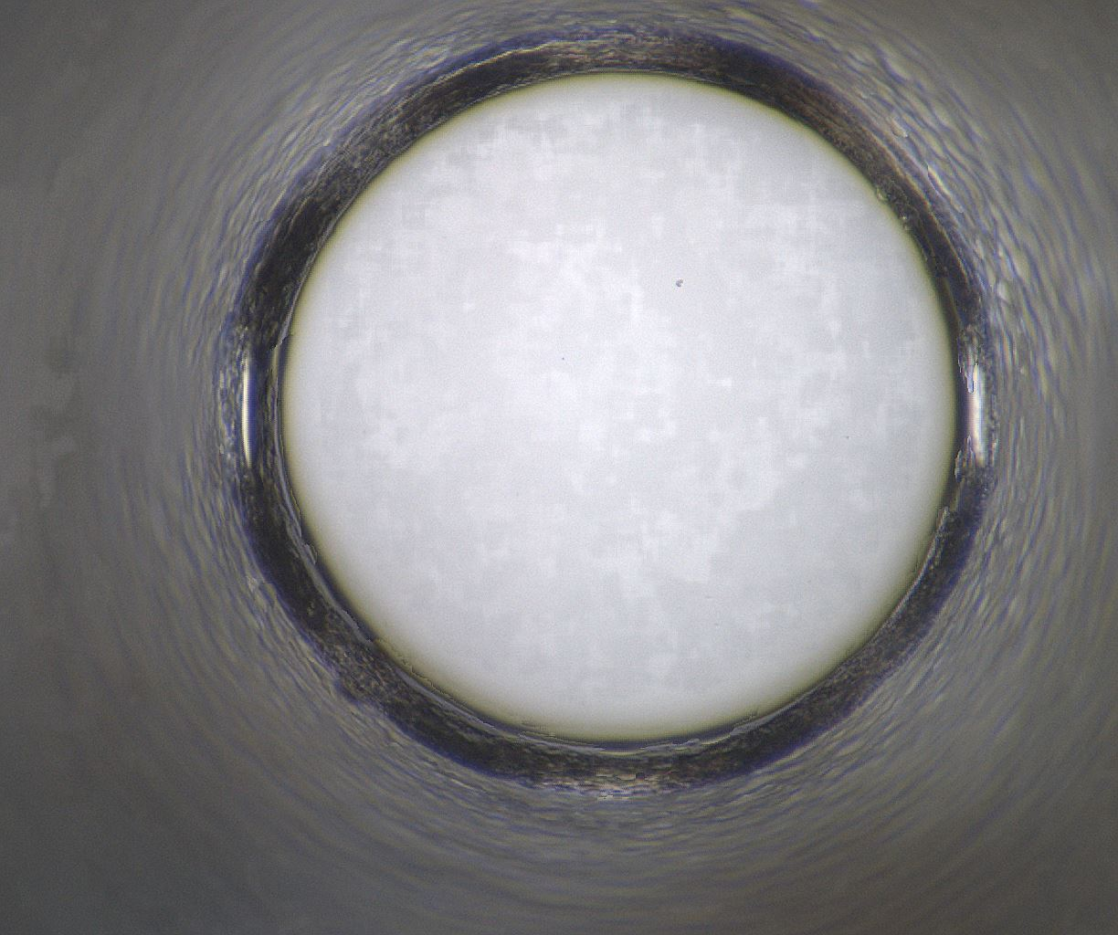
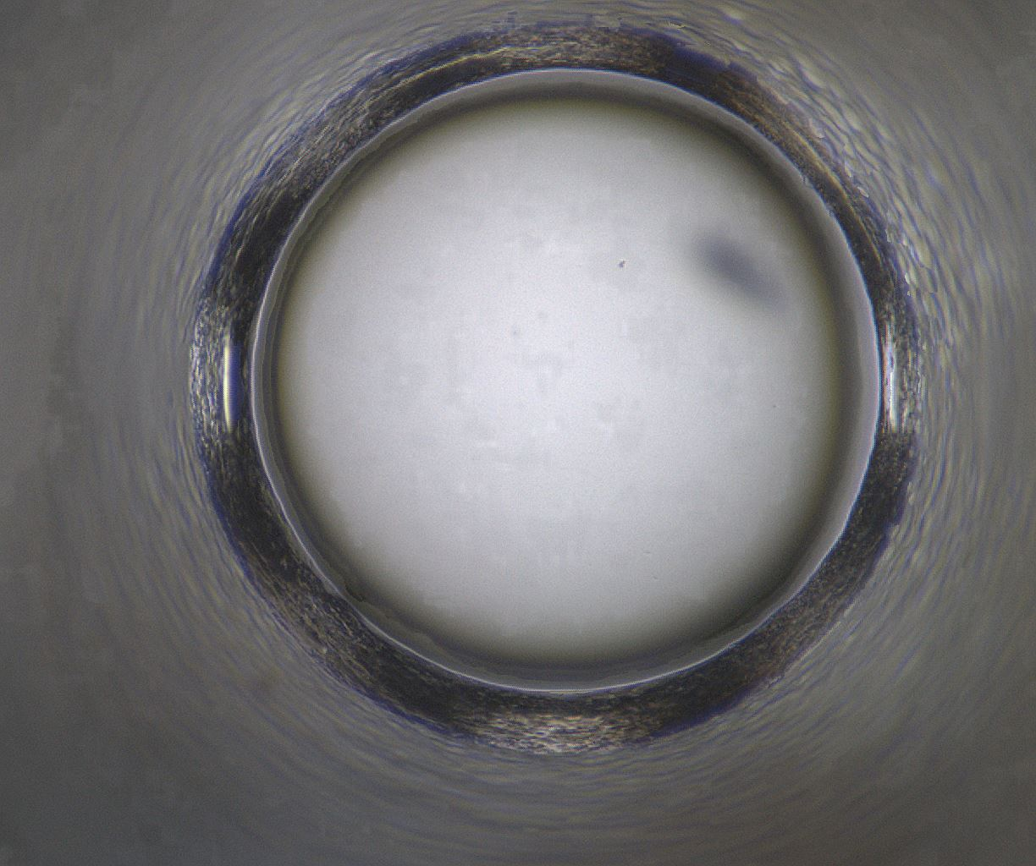
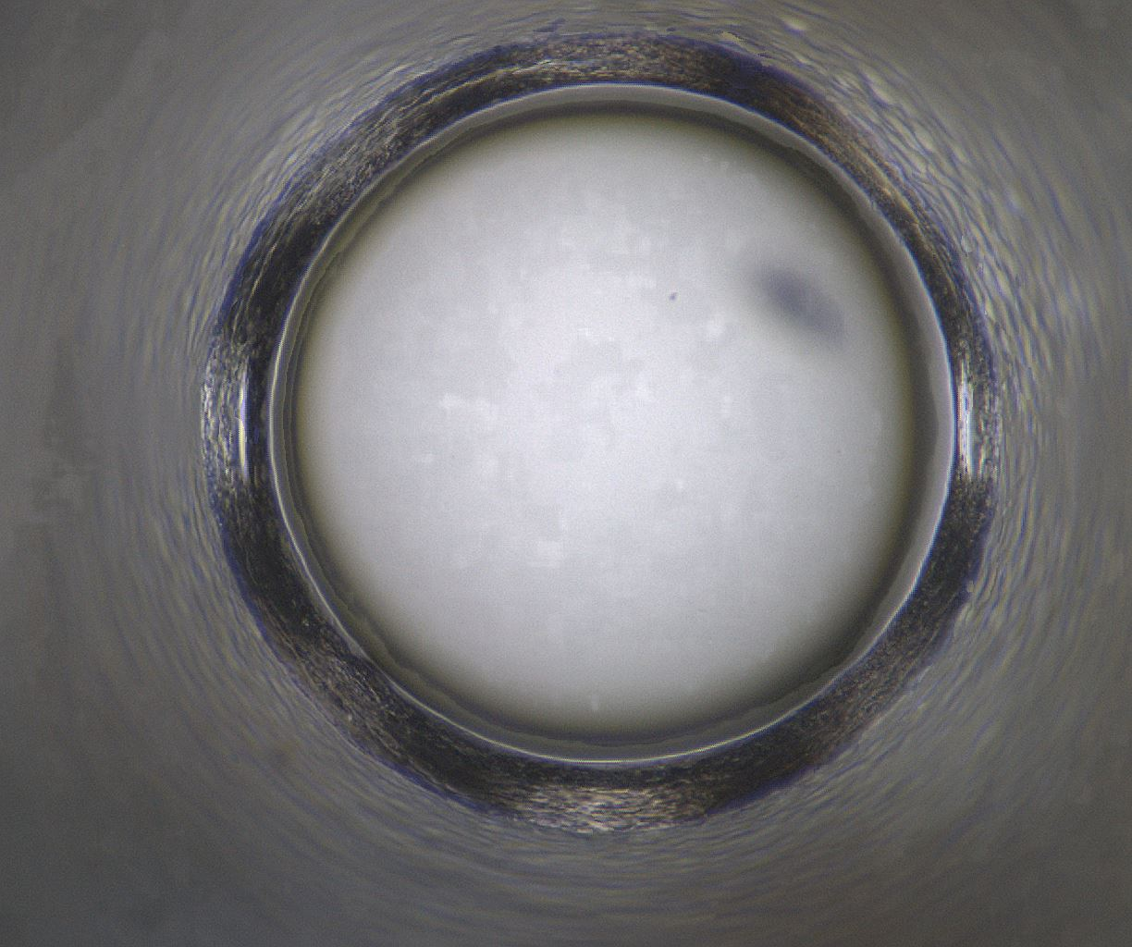
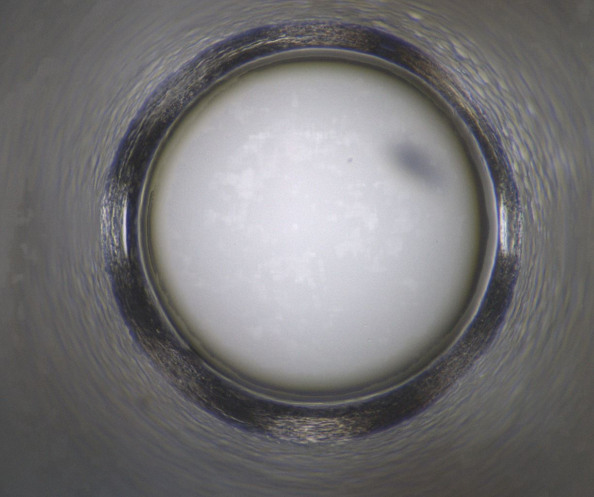
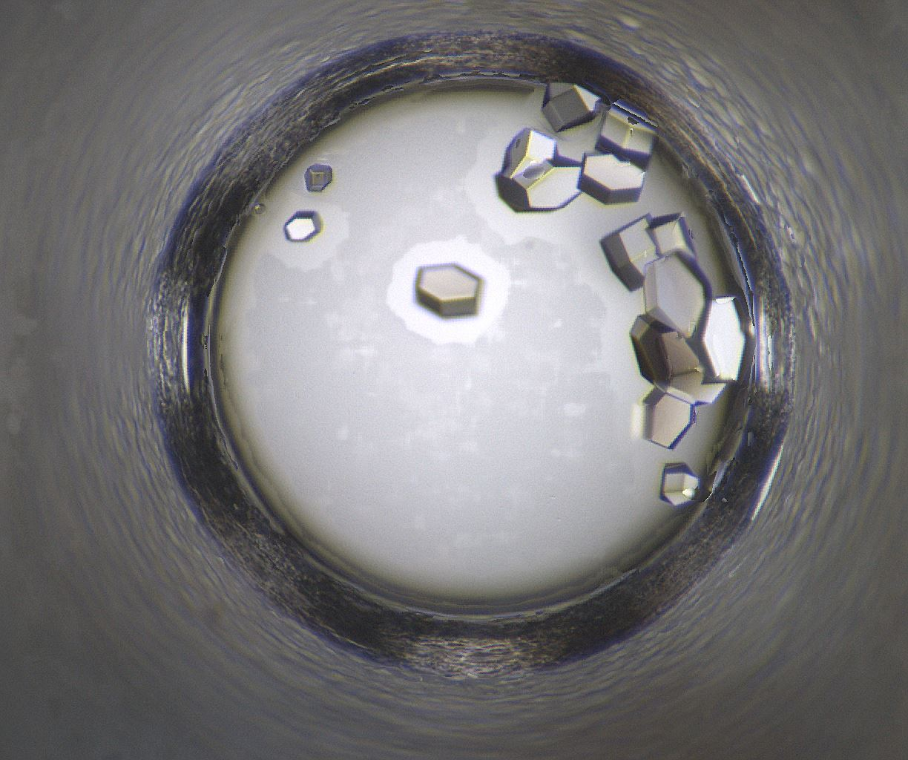
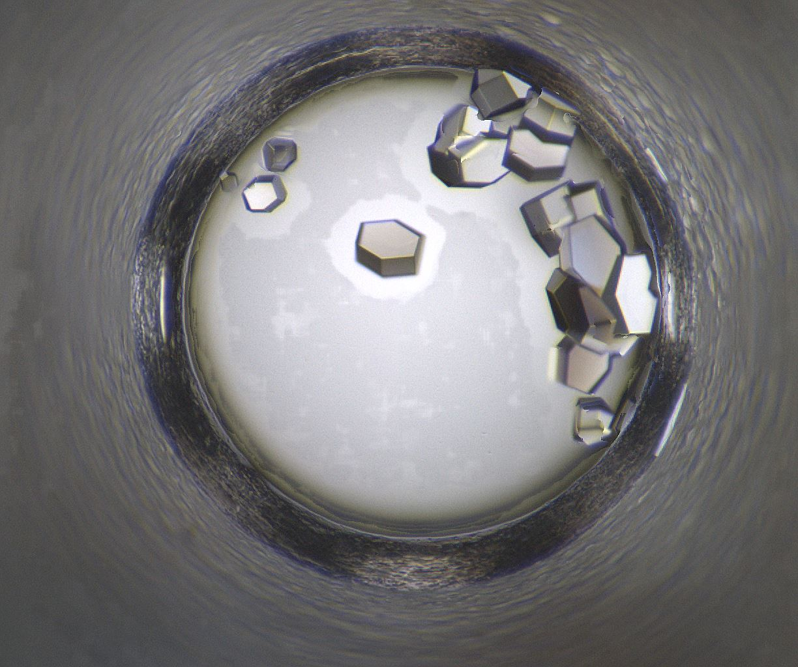
Well 205: 08/11/2020 - 08/22/2020
08/11/2020
08/12/2020
08/13/2020
08/15/2020
08/18/2020
08/19/2020
08/22/2020

Slide 11
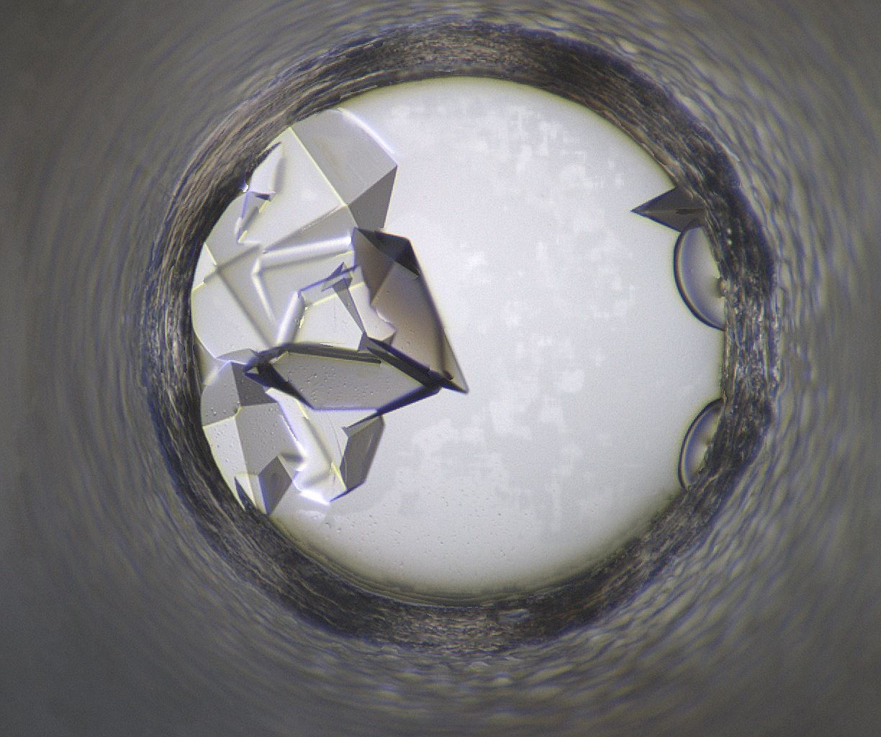
Well Number 245
Well Num: 245 MARCO Class: Crystals Human Class: Crystals MARCO Confidence: 93.4 % Date: 08/22/2020 Spectrum: Visible Cocktail 17_C0398 ------------------ pH: 9 Ammonium phosphate-monobasic 0.1 M TAPS 0.1 M PEG 8000 20.0 w/v

Slide 12

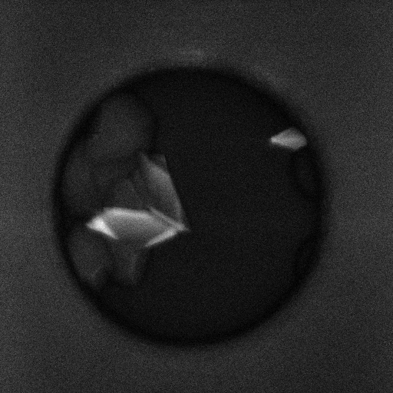
Well 245 Alternate Imagers
SHG
Visible
UV-TPEF

Slide 13
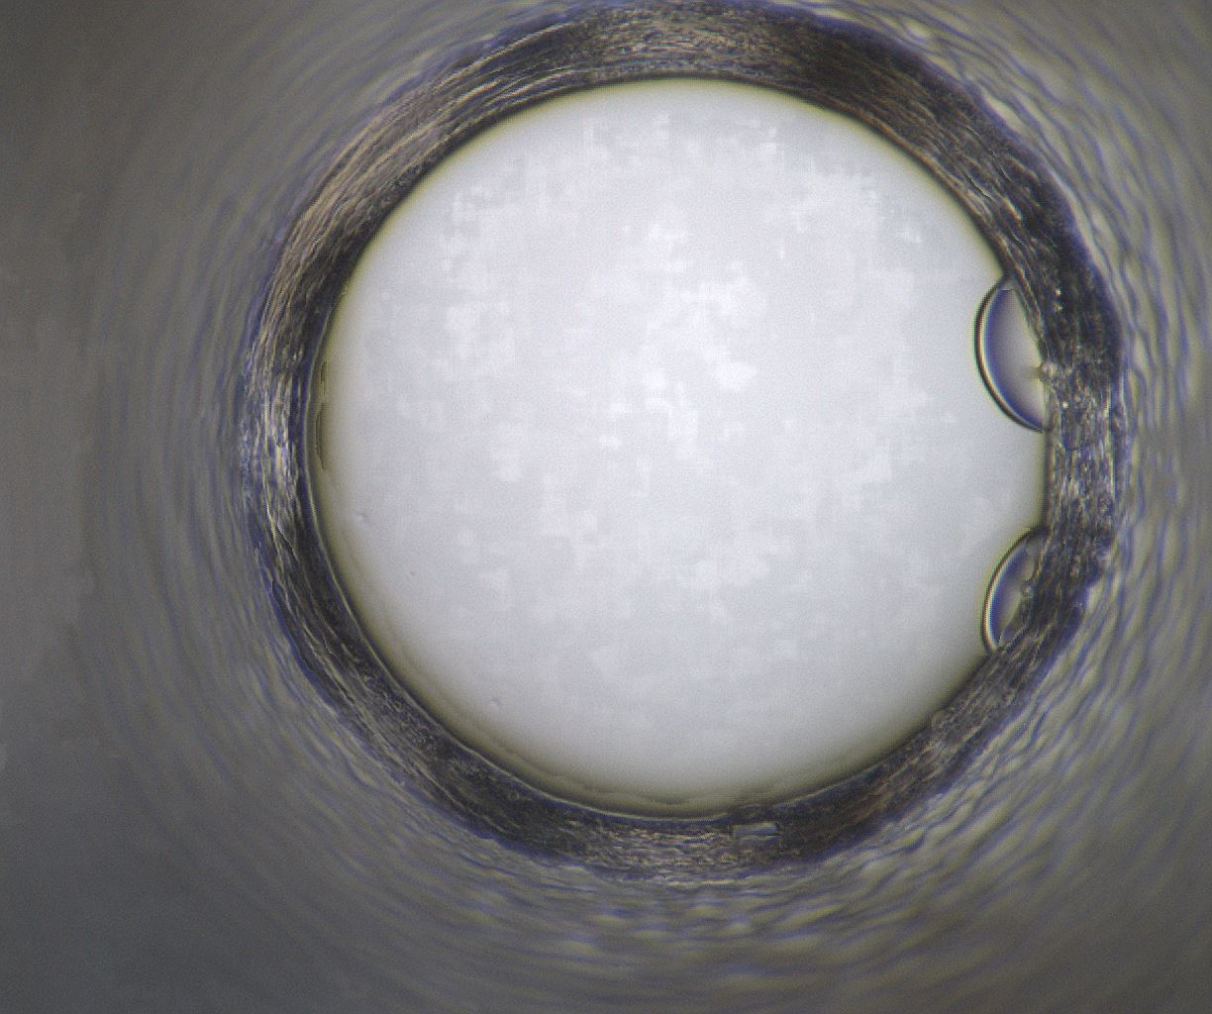
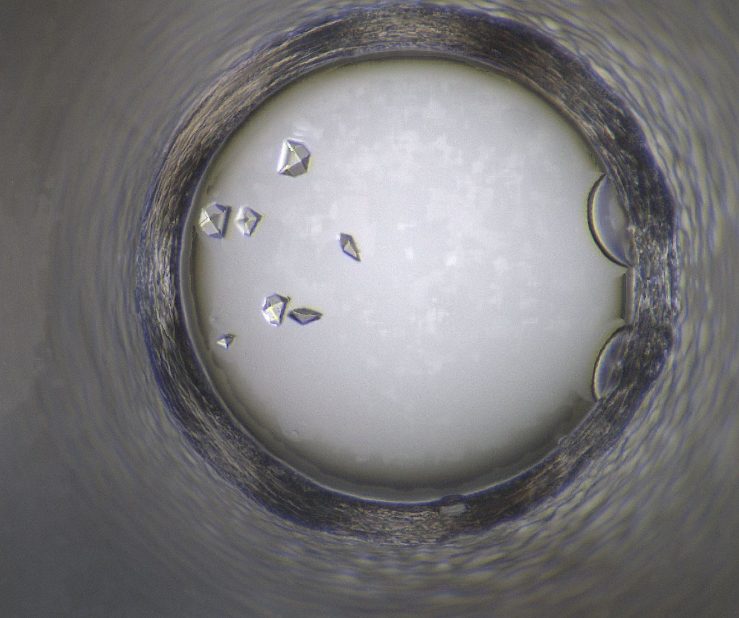
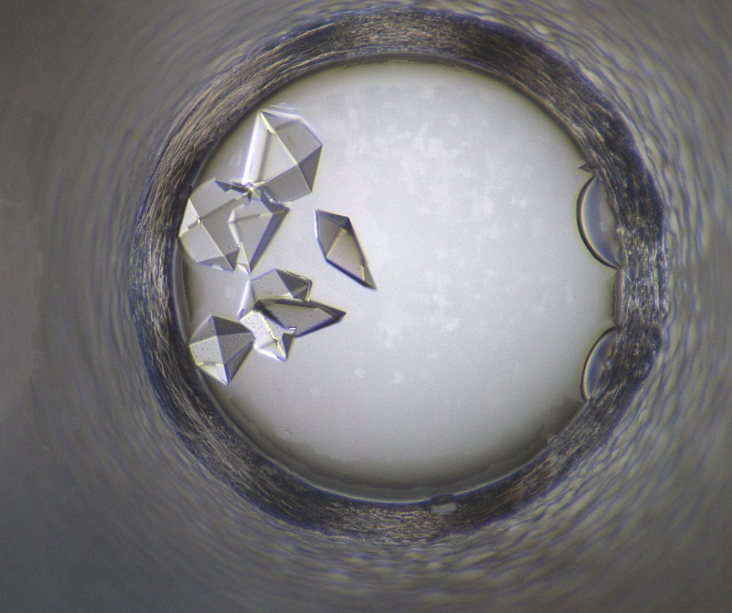
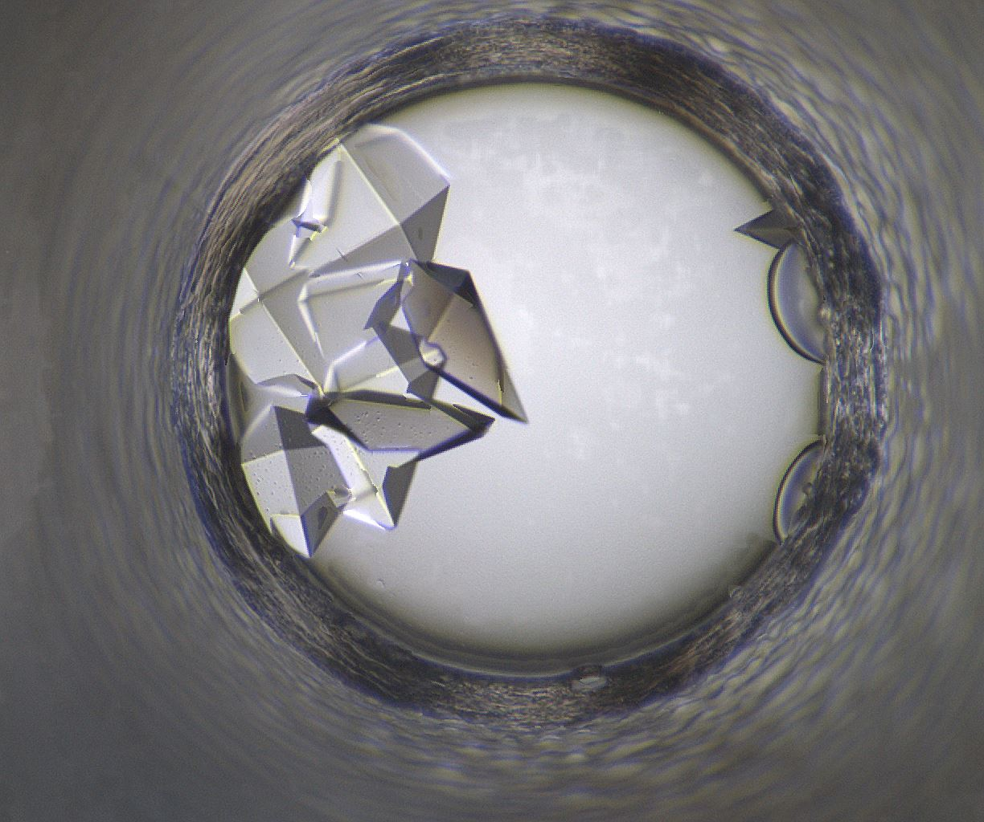
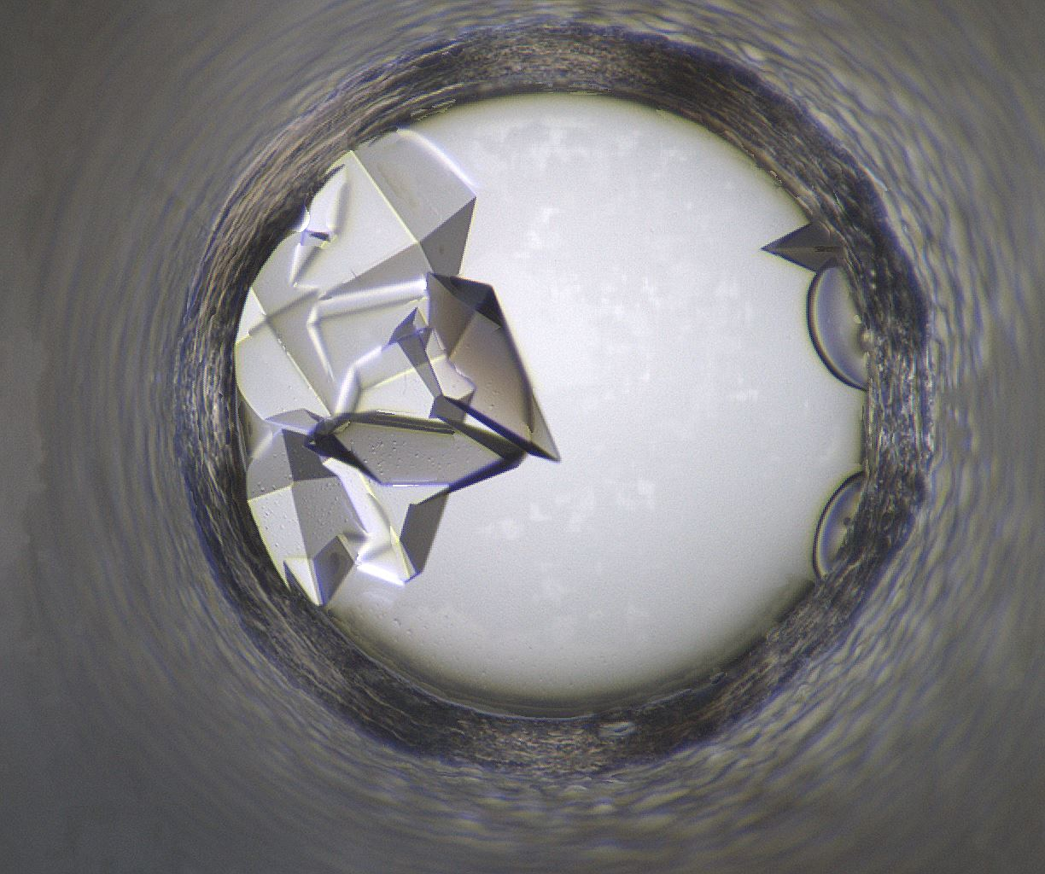
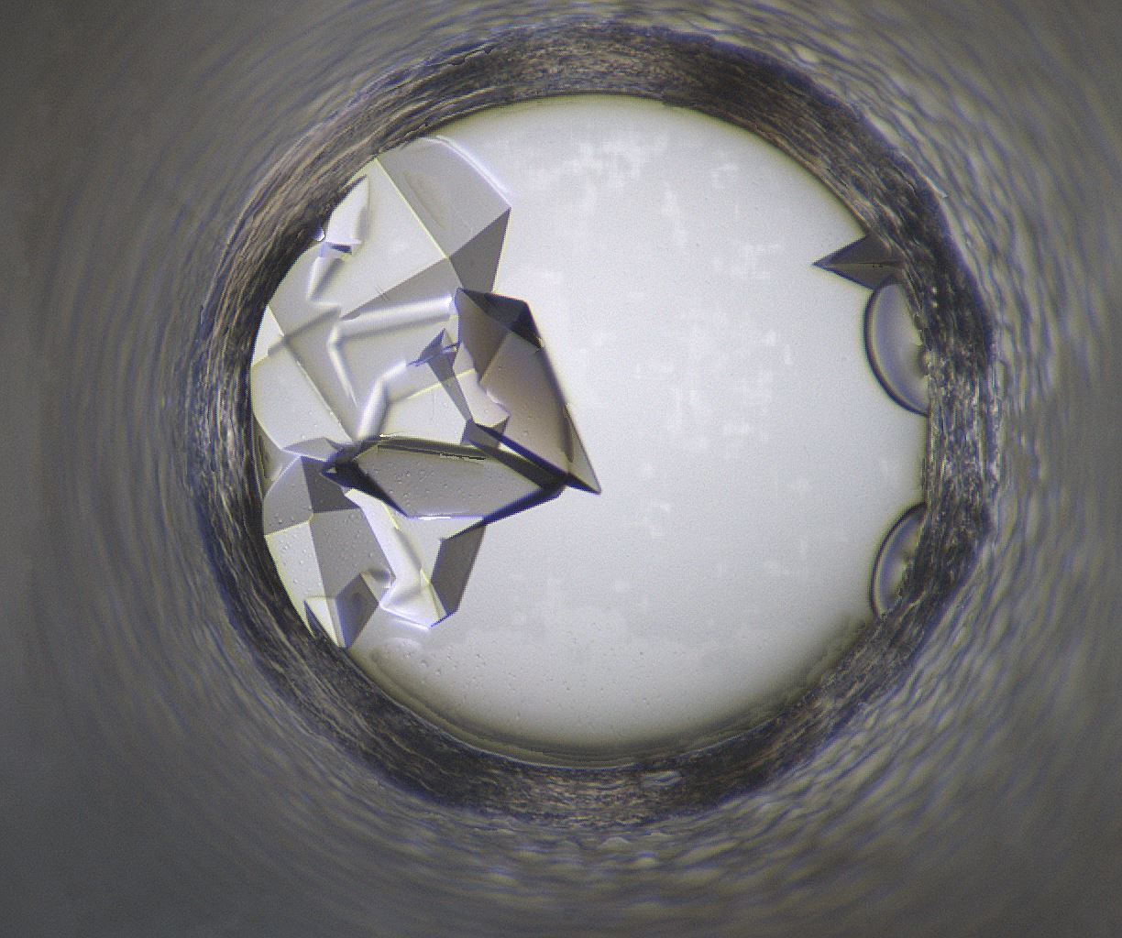
Well 245: 08/11/2020 - 08/22/2020
08/11/2020
08/12/2020
08/13/2020
08/15/2020
08/18/2020
08/19/2020
08/22/2020

Slide 14
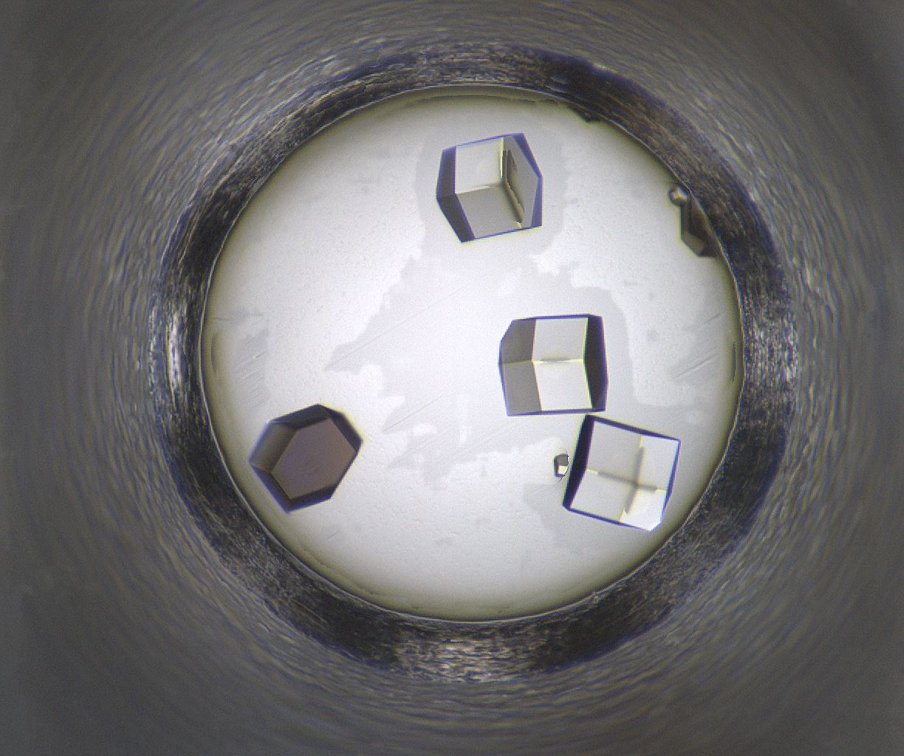
Well Number 302
Well Num: 302 MARCO Class: Crystals Human Class: Crystals MARCO Confidence: 93.5 % Date: 08/22/2020 Spectrum: Visible Cocktail 17_C0880 ------------------ pH: 7 Polyethylene glycol 10,000 20.0 w/v Tacsimate 10.0 v/v

Slide 15

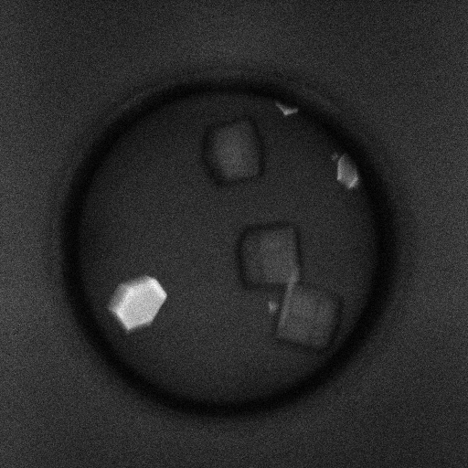
Well 302 Alternate Imagers
SHG
Visible
UV-TPEF

Slide 16
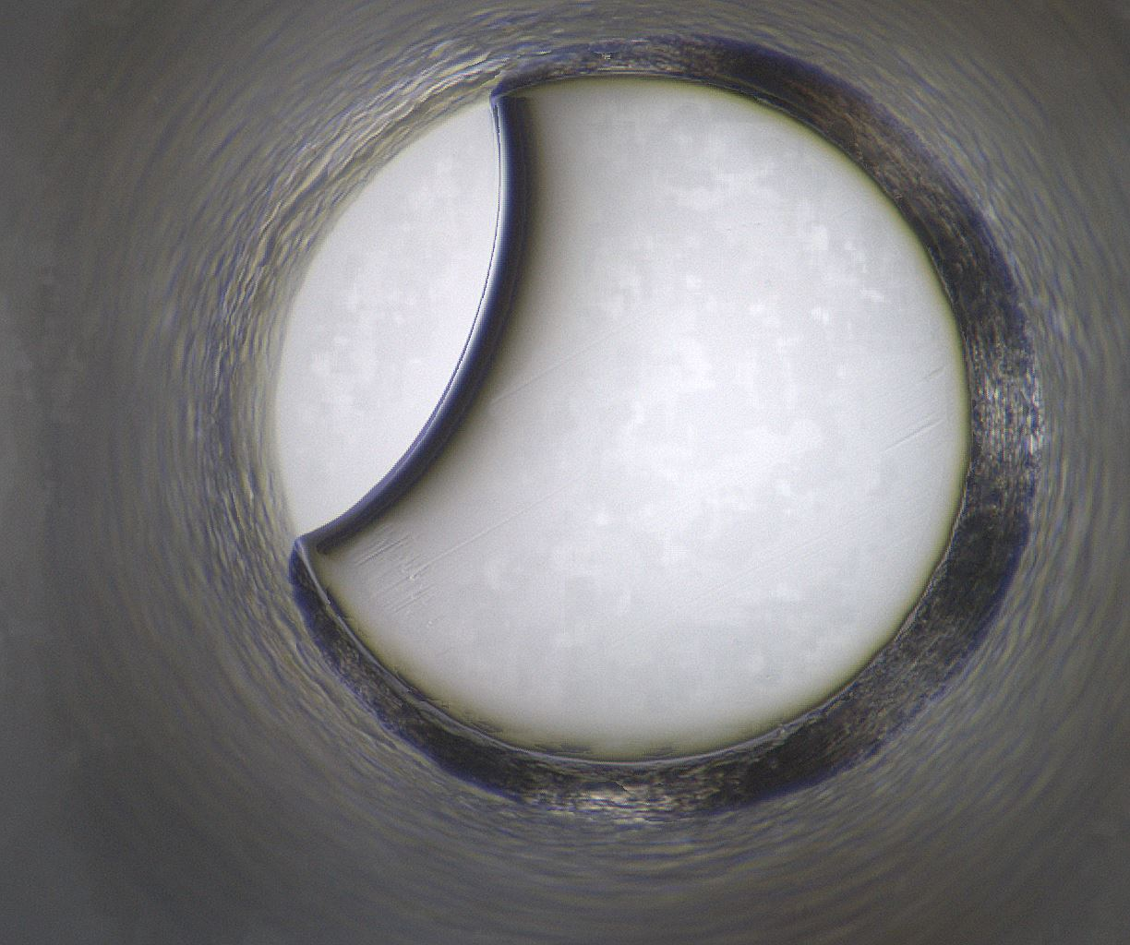
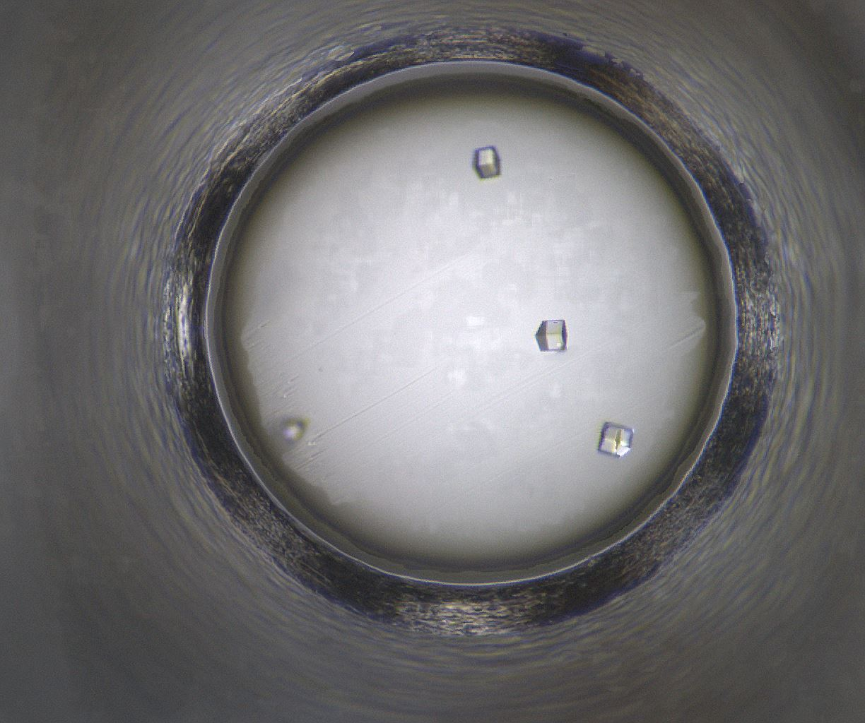
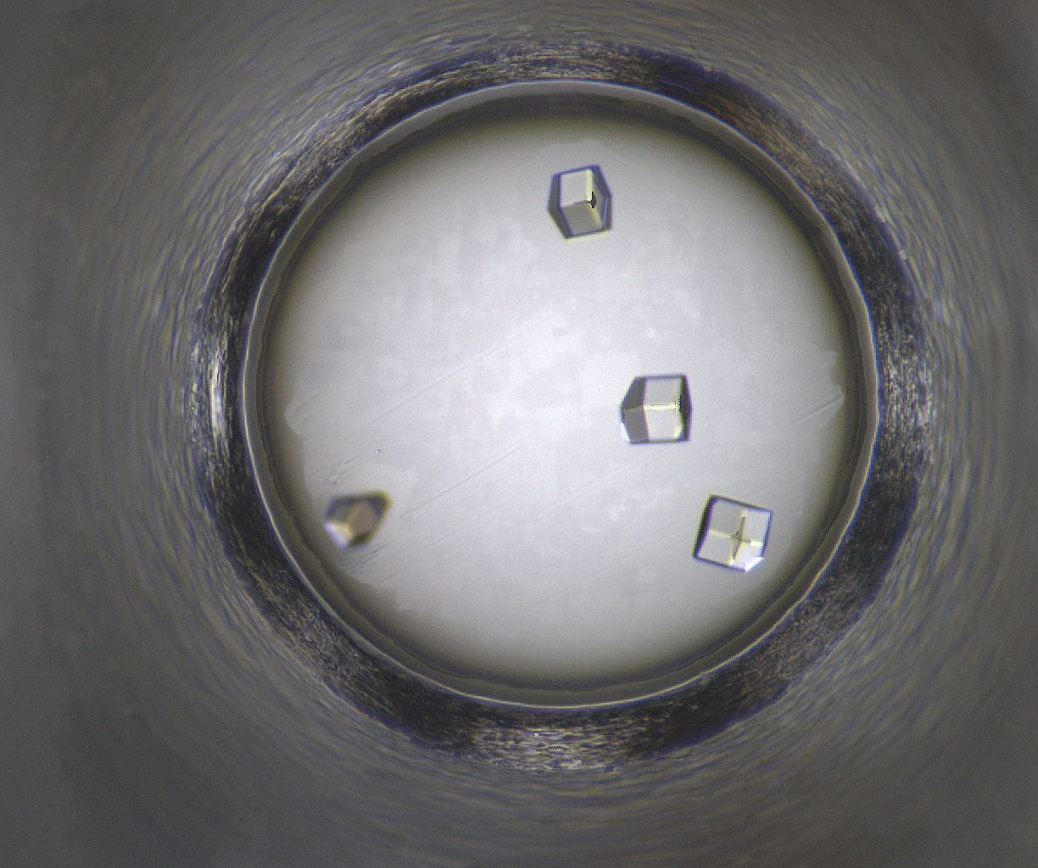
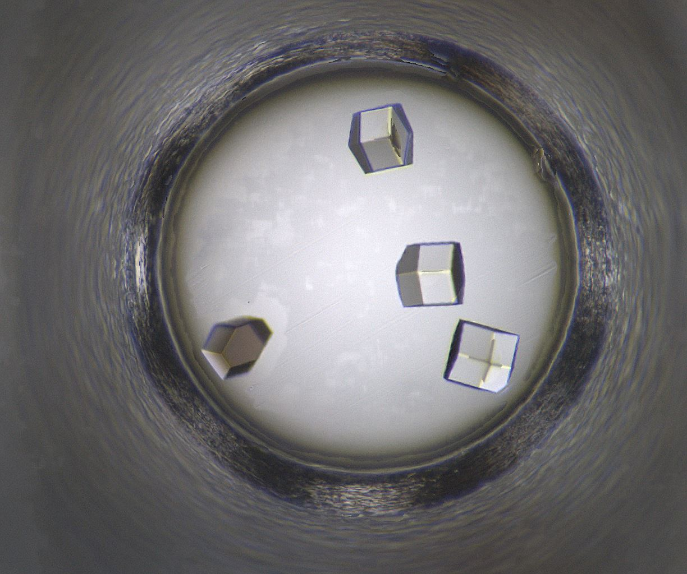
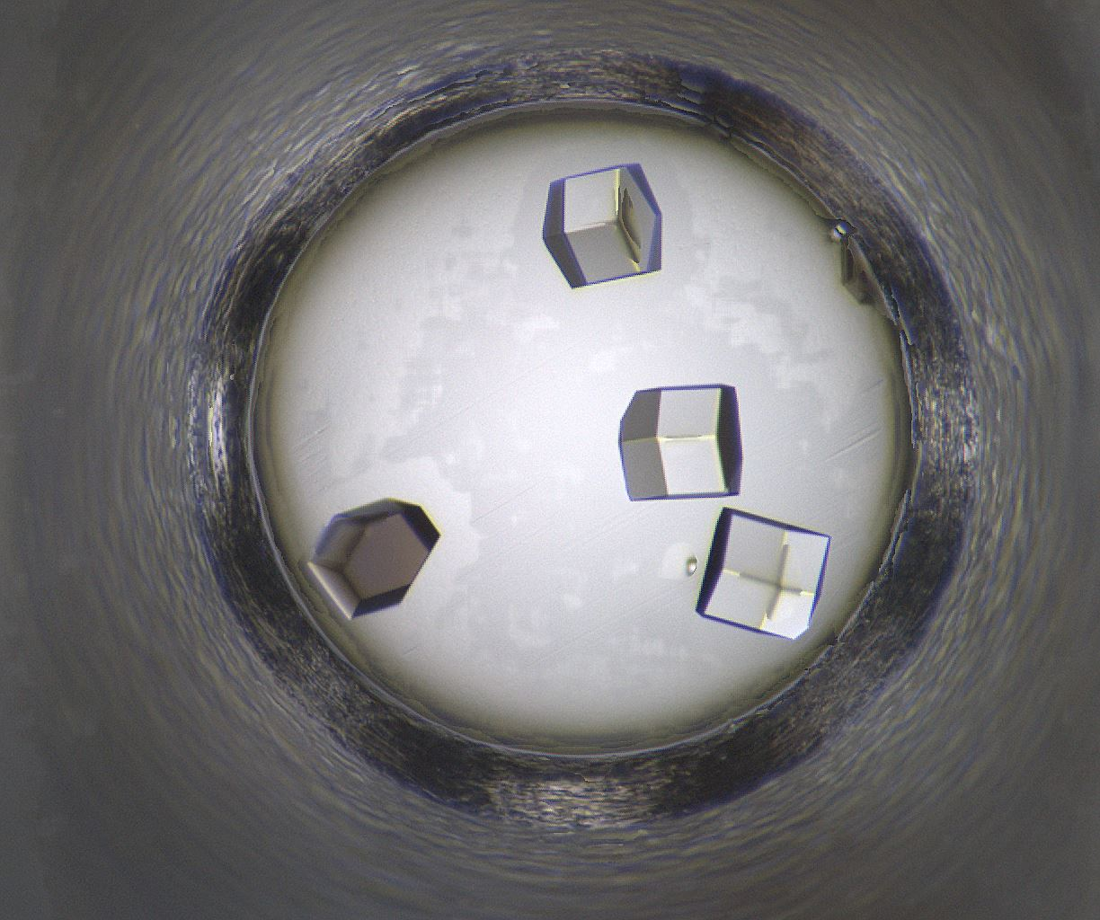
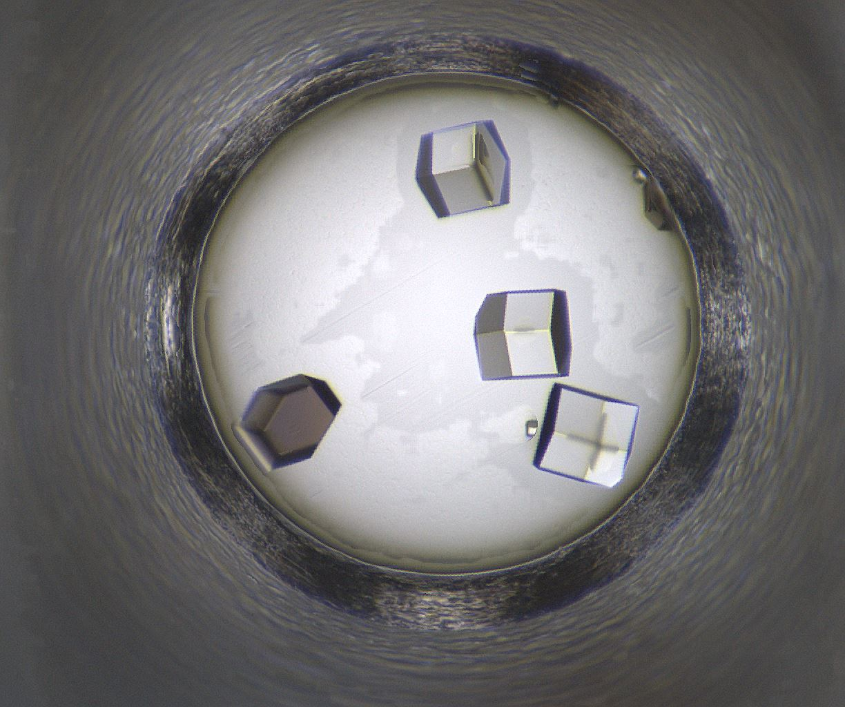
Well 302: 08/11/2020 - 08/22/2020
08/11/2020
08/12/2020
08/13/2020
08/15/2020
08/18/2020
08/19/2020
08/22/2020

Slide 17
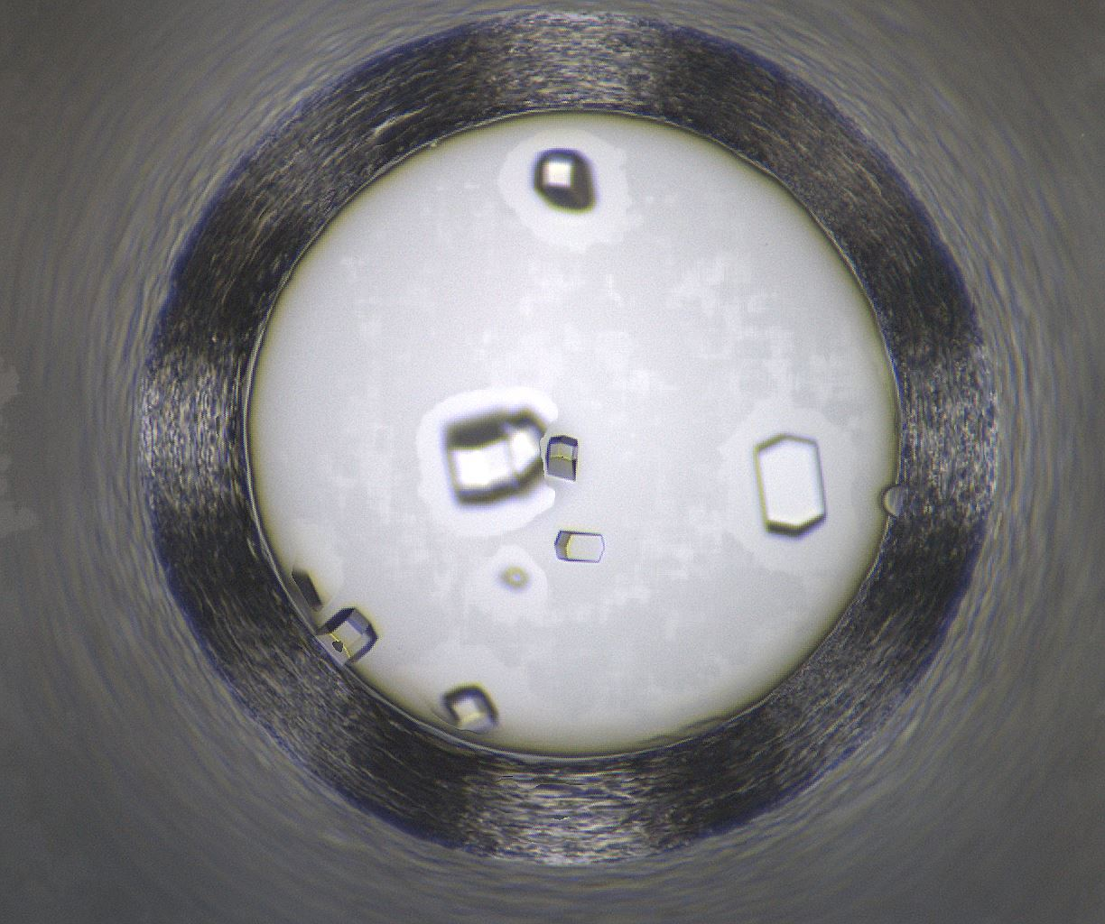
Well Number 359
Well Num: 359 MARCO Class: Crystals Human Class: Crystals MARCO Confidence: 93.5 % Date: 08/22/2020 Spectrum: Visible Cocktail 17_C0690 ------------------ pH: 7 Polyethylene glycol 600 20.0 v/v Tacsimate 10.0 v/v

Slide 18

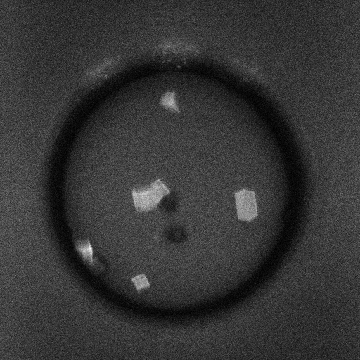
Well 359 Alternate Imagers
SHG
Visible
UV-TPEF

Slide 19
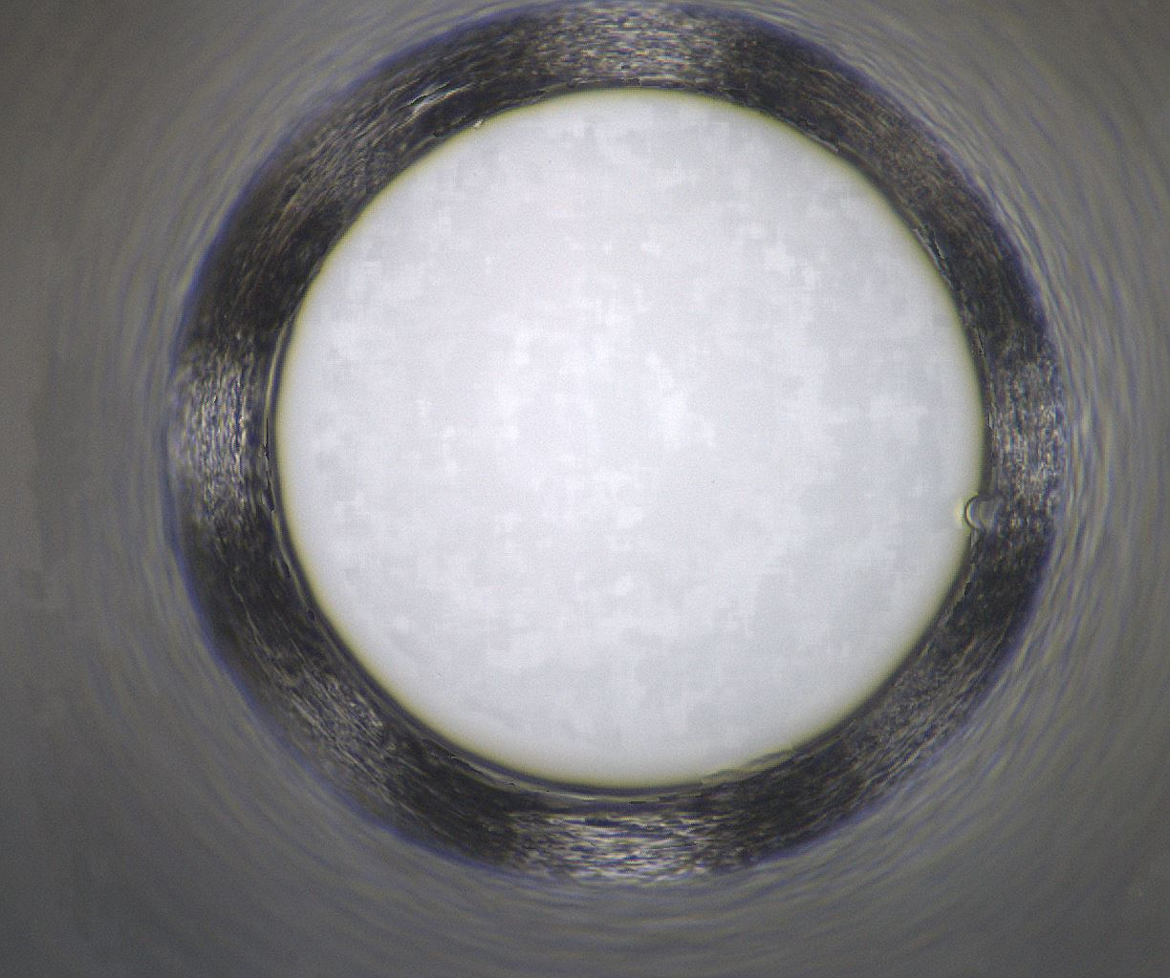
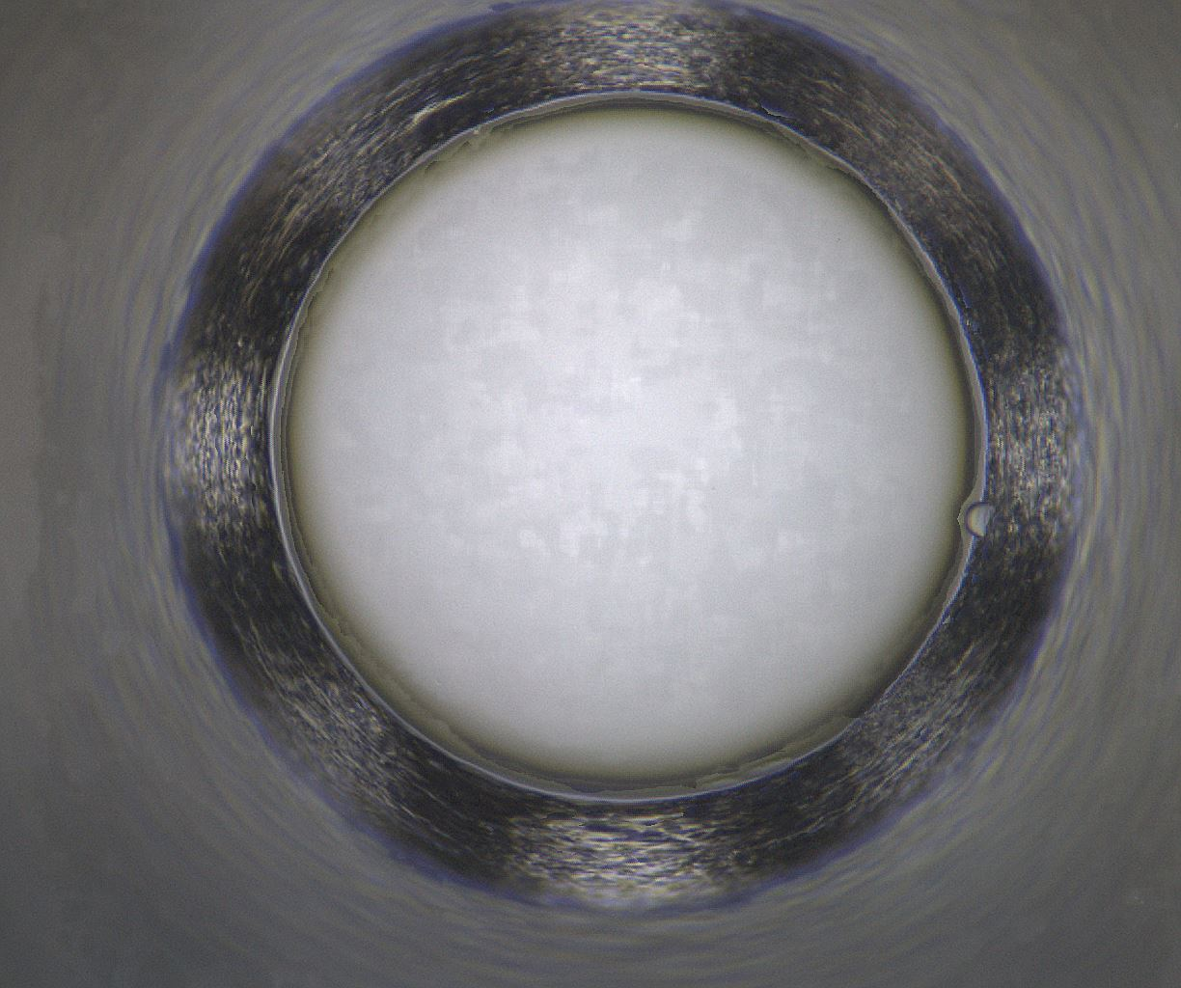
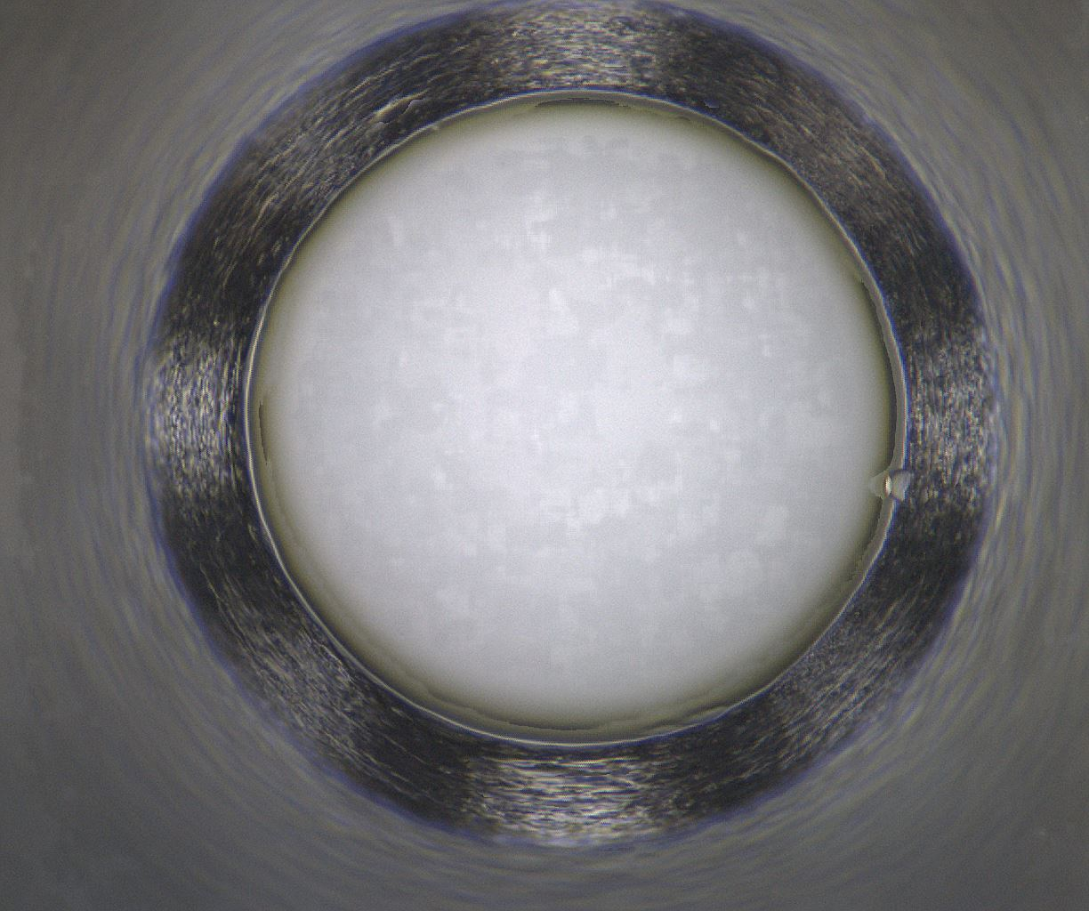
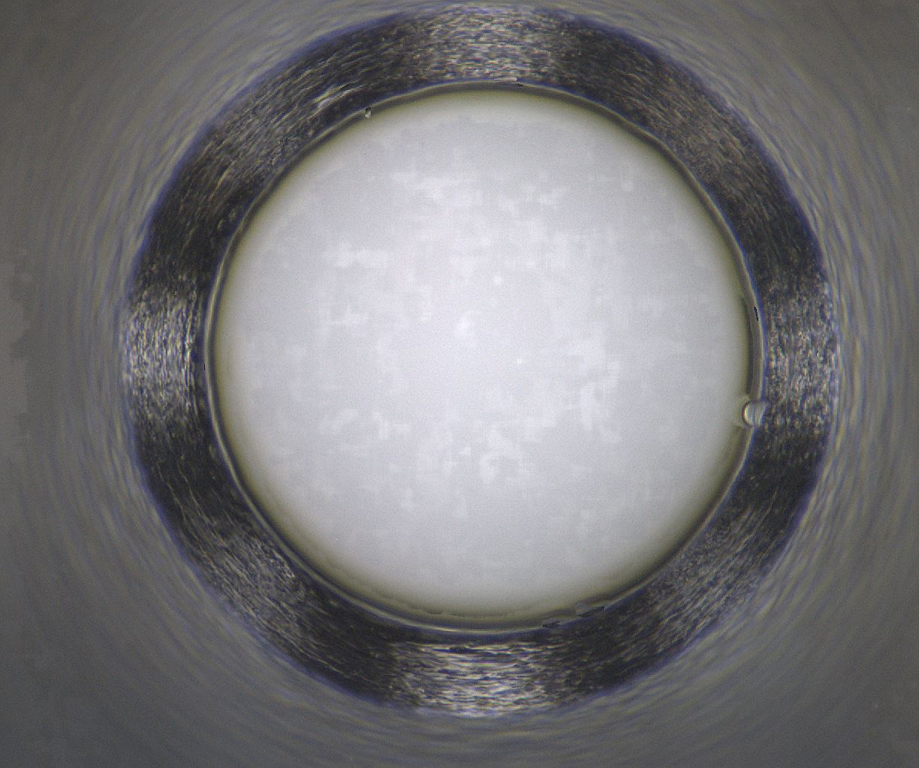
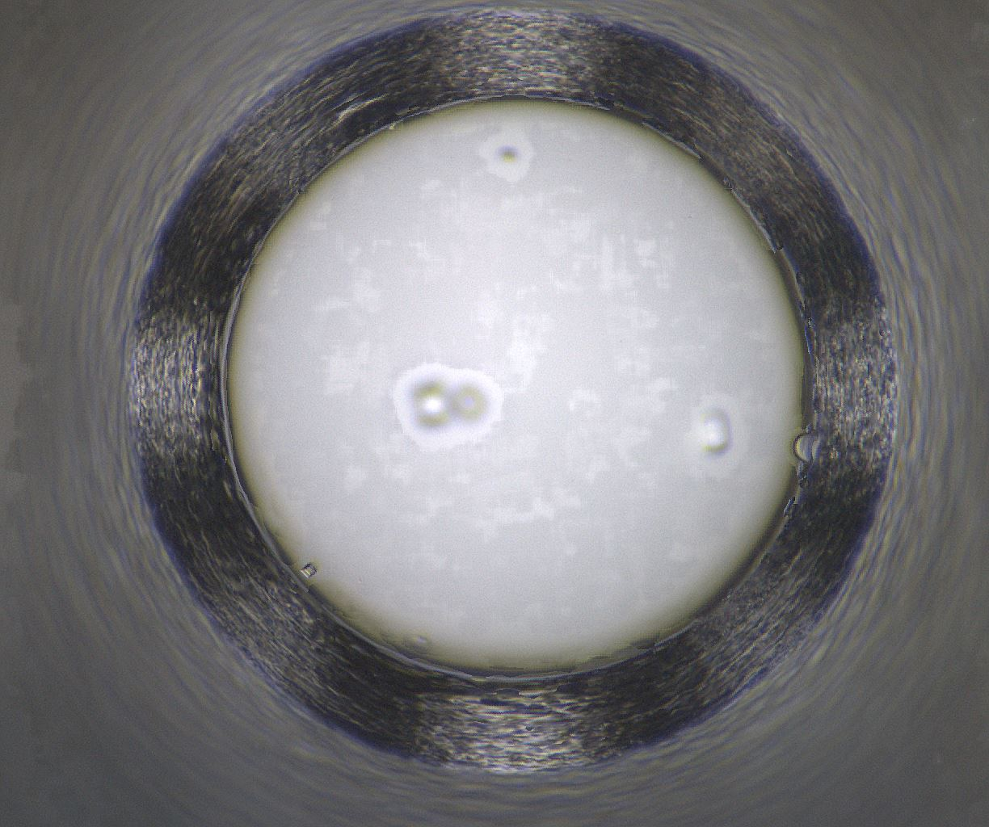
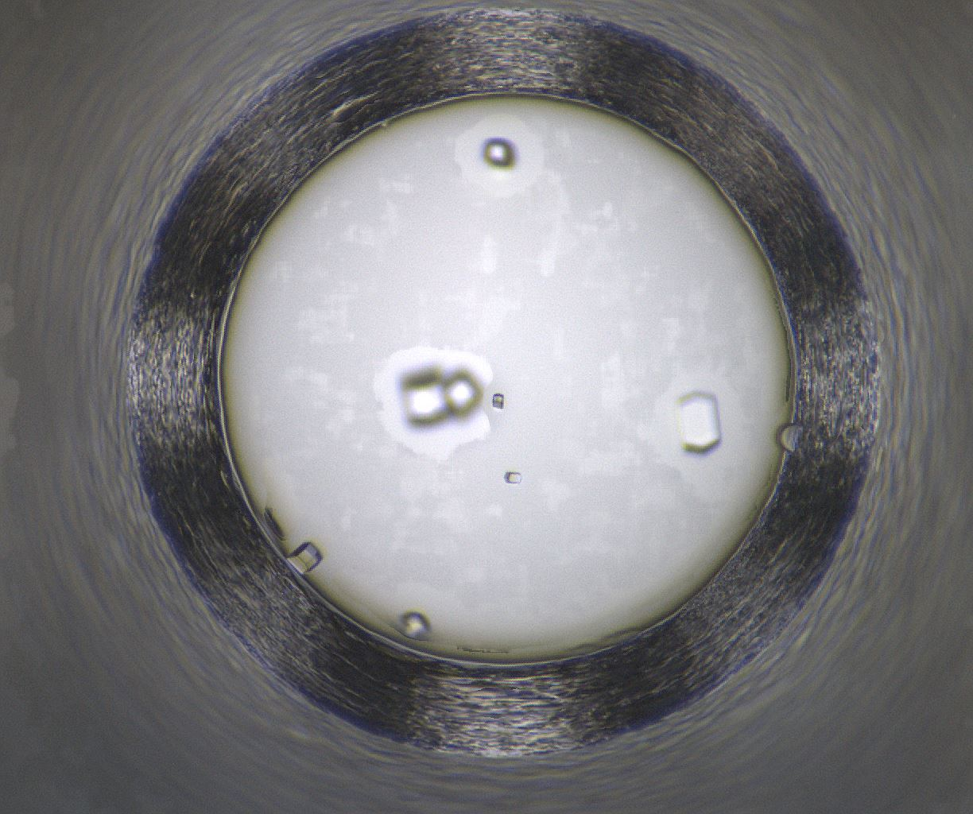
Well 359: 08/11/2020 - 08/22/2020
08/11/2020
08/12/2020
08/13/2020
08/15/2020
08/18/2020
08/19/2020
08/22/2020

Slide 20
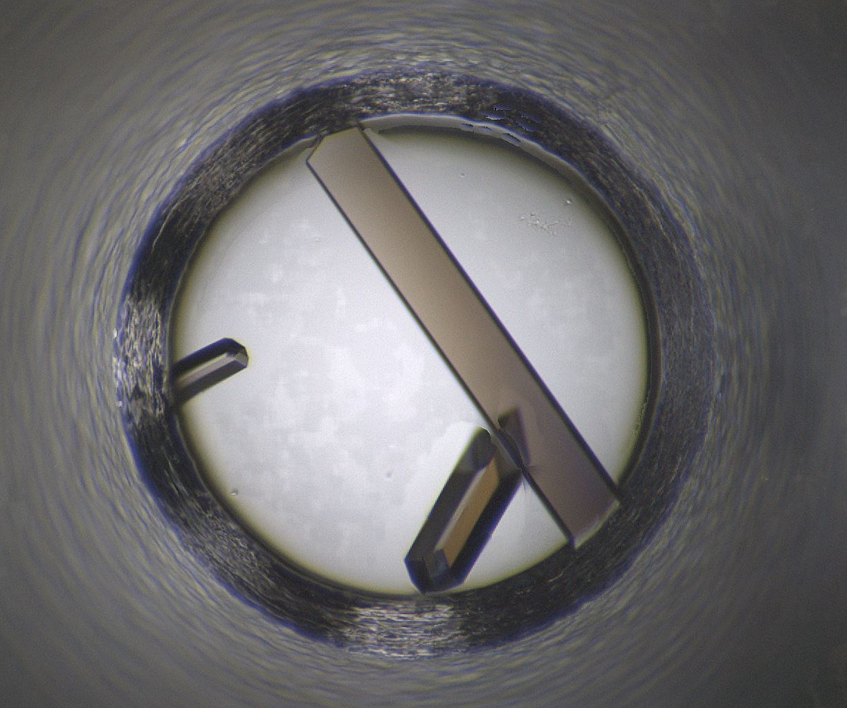
Well Number 480
Well Num: 480 MARCO Class: Crystals Human Class: Crystals MARCO Confidence: 93.7 % Date: 08/22/2020 Spectrum: Visible Cocktail 17_C1380 ------------------ pH: 7 Tacsimate pH 7.0 15.0 w/v HEPES 0.1 M PEG 3350 2.0 w/v

Slide 21
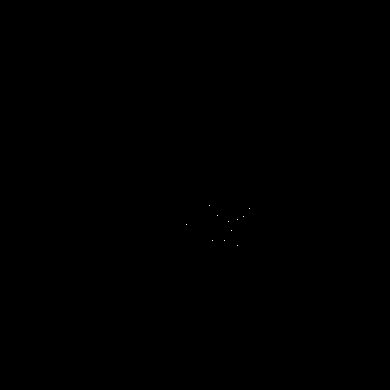
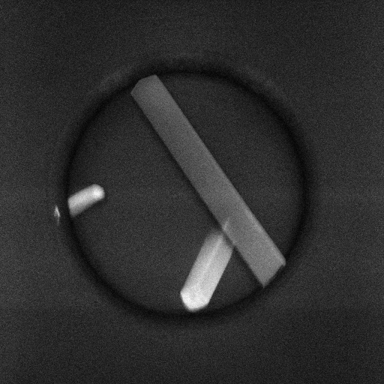
Well 480 Alternate Imagers
SHG
Visible
UV-TPEF

Slide 22






Well 480: 08/11/2020 - 08/22/2020
08/11/2020
08/12/2020
08/13/2020
08/15/2020
08/18/2020
08/19/2020
08/22/2020

Slide 23

Well Number 632
Well Num: 632 MARCO Class: Crystals Human Class: Crystals MARCO Confidence: 93.5 % Date: 08/22/2020 Spectrum: Visible Cocktail 17_C1382 ------------------ pH: 7 HEPES 0.1 M Jeffamine M-600 reagent pH 7.0 30.0 v/v

Slide 24


Well 632 Alternate Imagers
SHG
Visible
UV-TPEF

Slide 25






Well 632: 08/11/2020 - 08/22/2020
08/11/2020
08/12/2020
08/13/2020
08/15/2020
08/18/2020
08/19/2020
08/22/2020

Slide 26

Well Number 718
Well Num: 718 MARCO Class: Crystals Human Class: Crystals MARCO Confidence: 93.6 % Date: 08/22/2020 Spectrum: Visible Cocktail 17_C0912 ------------------ pH: 4.2 Ammonium thiocyanate 0.1 M Sodium Citrate 0.1 M PEG 400 40.0 v/v

Slide 27


Well 718 Alternate Imagers
SHG
Visible
UV-TPEF

Slide 28






Well 718: 08/11/2020 - 08/22/2020
08/11/2020
08/12/2020
08/13/2020
08/15/2020
08/18/2020
08/19/2020
08/22/2020

Slide 29

Well Number 838
Well Num: 838 MARCO Class: Crystals Human Class: Crystals MARCO Confidence: 93.7 % Date: 08/22/2020 Spectrum: Visible Cocktail 17_C1206 ------------------ pH: 6 Sodium Malonate 0.2 M PEG 3350 20.0 w/v

Slide 30


Well 838 Alternate Imagers
SHG
Visible
UV-TPEF

Slide 31






Well 838: 08/11/2020 - 08/22/2020
08/11/2020
08/12/2020
08/13/2020
08/15/2020
08/18/2020
08/19/2020
08/22/2020

Slide 32

Well Number 1054
Well Num: 1054 MARCO Class: Crystals Human Class: Crystals MARCO Confidence: 93.7 % Date: 08/22/2020 Spectrum: Visible Cocktail 17_C1224 ------------------ pH: 7 DL-Malic acid 0.2 M PEG 3350 20.0 w/v

Slide 33


Well 1054 Alternate Imagers
SHG
Visible
UV-TPEF

Slide 34






Well 1054: 08/11/2020 - 08/22/2020
08/11/2020
08/12/2020
08/13/2020
08/15/2020
08/18/2020
08/19/2020
08/22/2020

